Slide 1

TorchQuantum Tutorial
Hanrui Wang, Song Han (MIT)
Zhiding Liang, Yiyu Shi (Notre Dame)
Jinglei Cheng, Xuehai Qian (Purdue)
Zhepeng Wang, Weiwen Jiang (GMU)
Jiaqi Gu, David Pan (UT Austin)
Zirui Li (Rutgers)
Yongshan Ding (Yale)
Fred Chong (UChicago)
https://torchquantum.org
QCE 2022

Slide 2

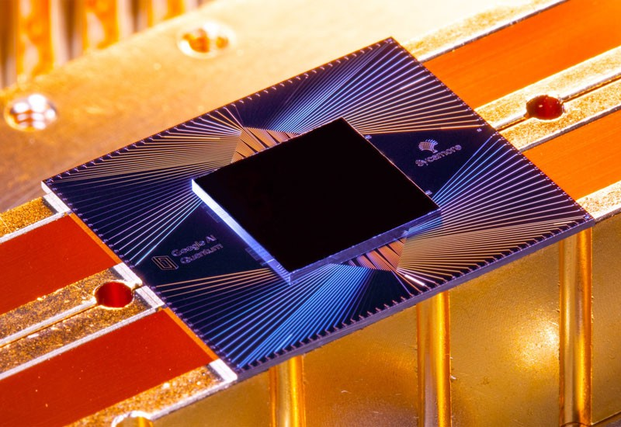
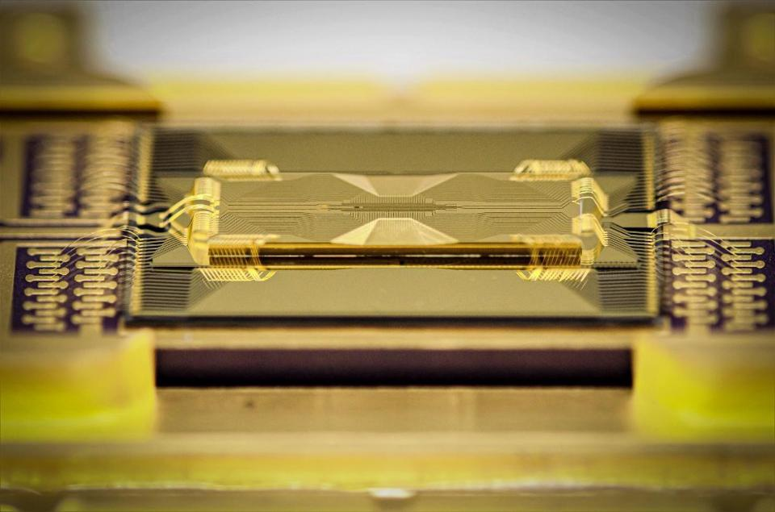
Quantum Computing
Fast progress of quantum devices
Different technologies
Superconducting, trapped ion, neutral atom, photonics, etc.
IBM 127 Qubit
Google 53 Qubits
IonQ 32+ Qubits
Notes:
The current pace of hardware development in quantum computing is very fast
We have different technologies
The number of qubits

Slide 3
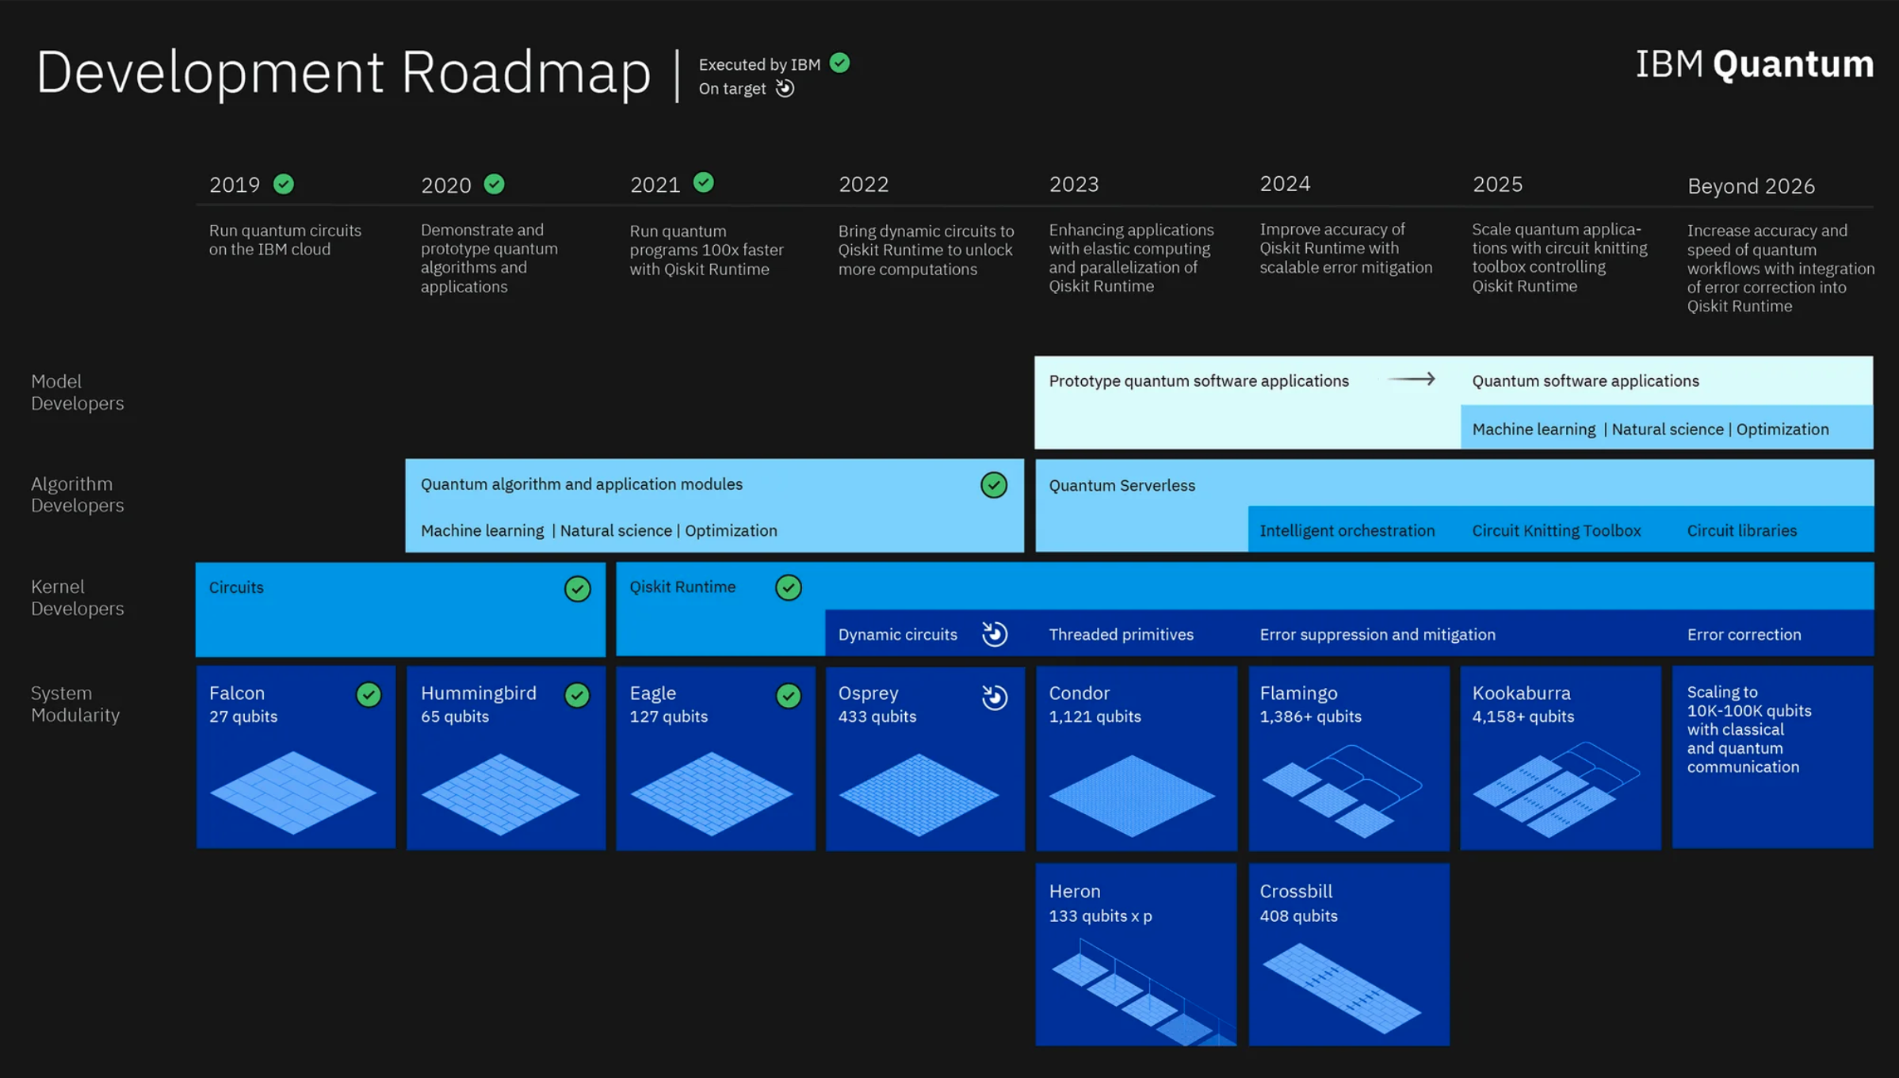
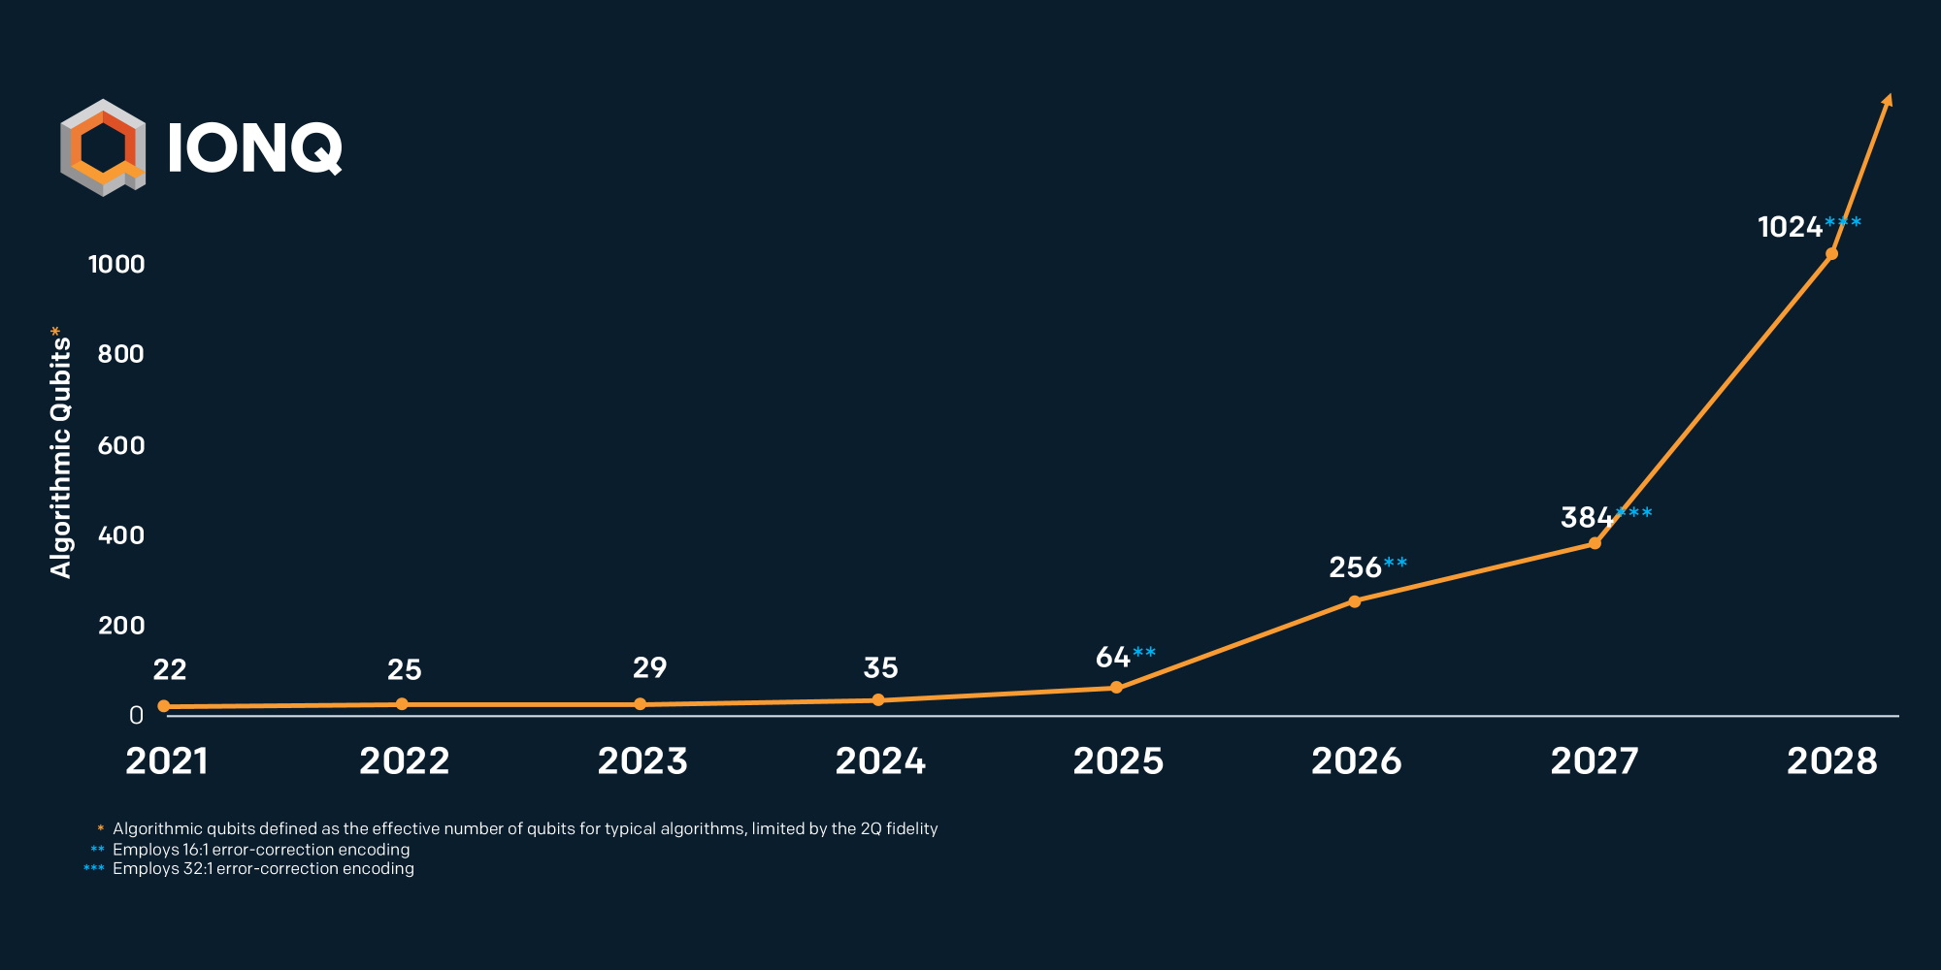
Quantum Computing
The number of qubits increases exponentially over time
The computing power increases exponentially with the number of qubits
=> “doubly exponential” rate
Double exponentially increasing computing power
IBM Roadmap
IonQ Roadmap
Notes:
The number of qubits increases exponentially over time
The computing power increases exponentially over number of qubits
So it’s a double exponential increase

Slide 4
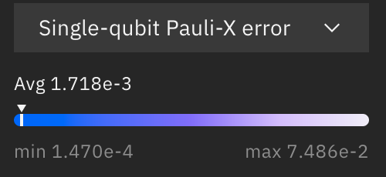
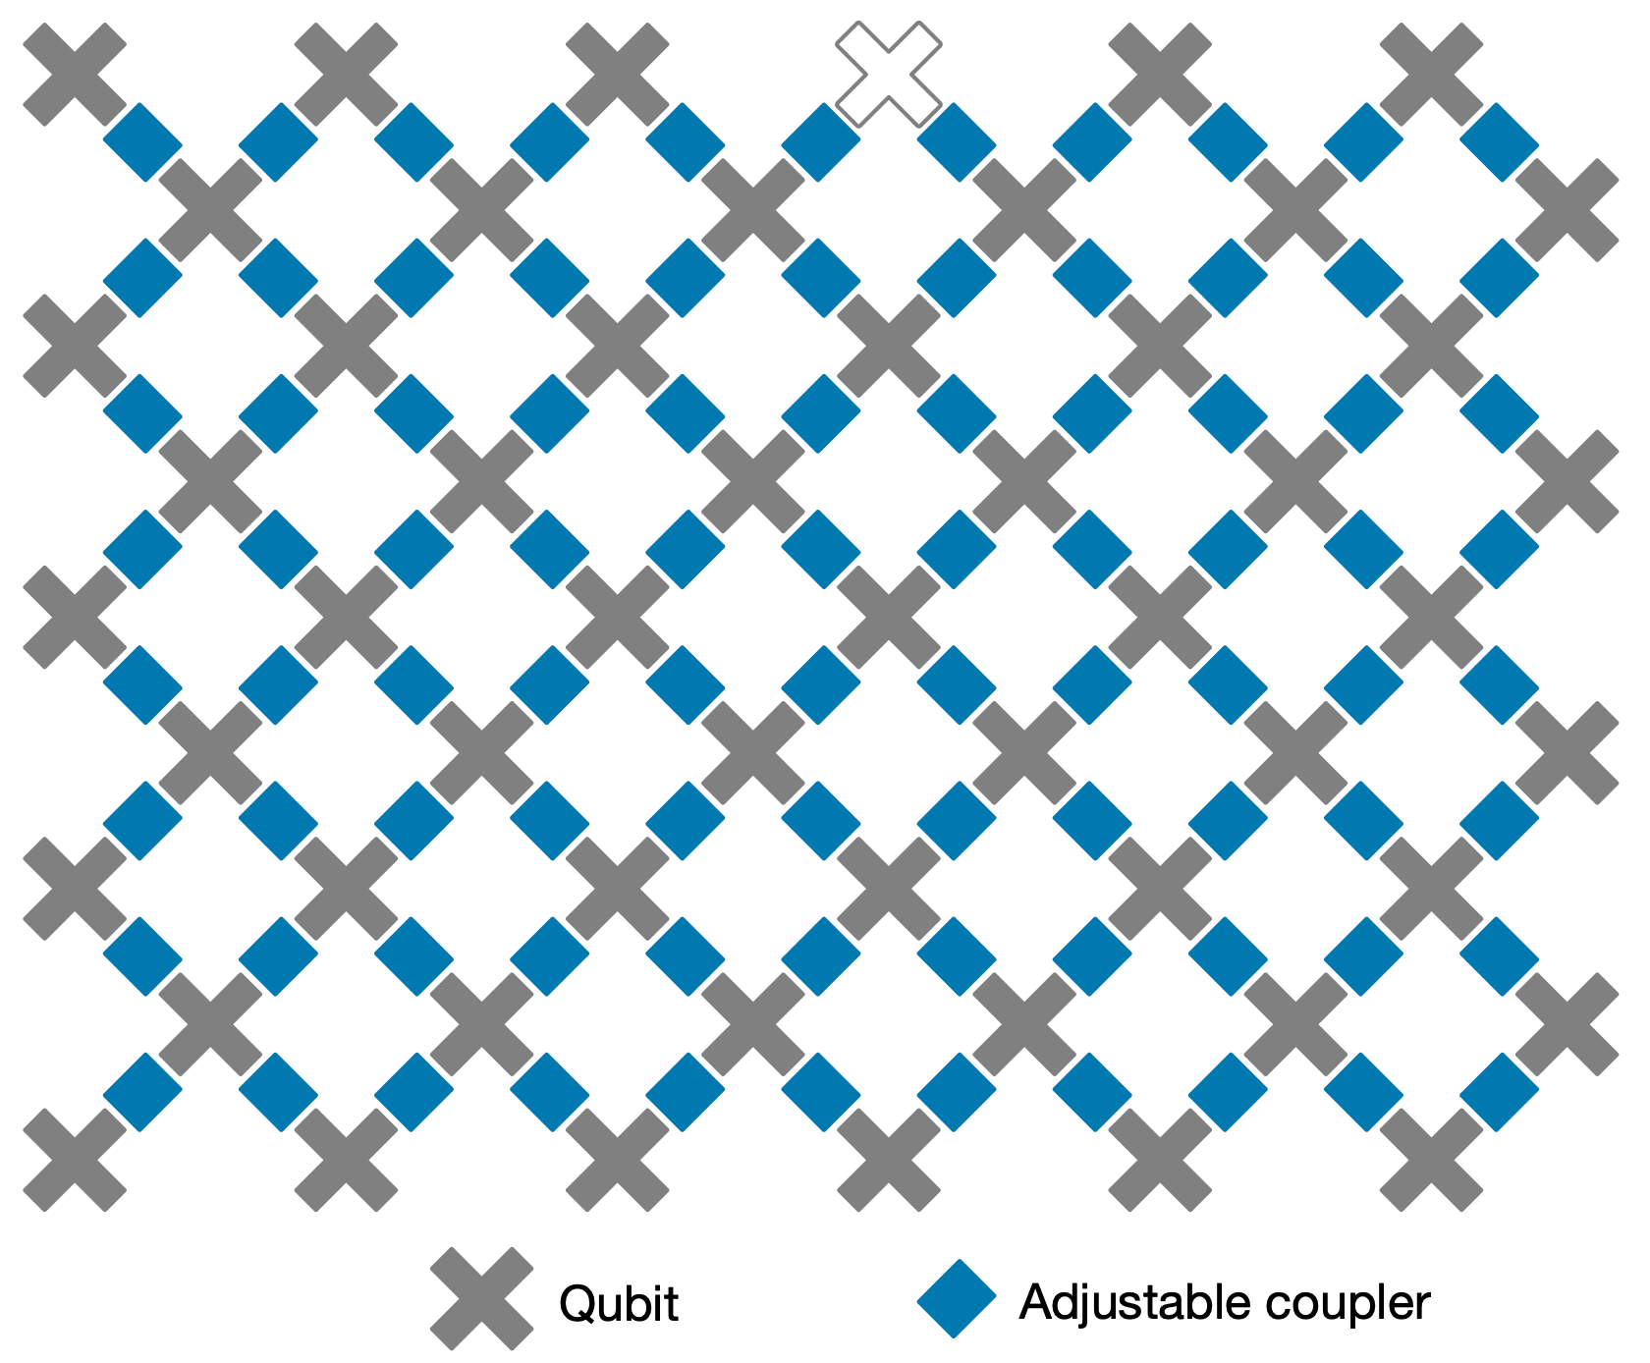
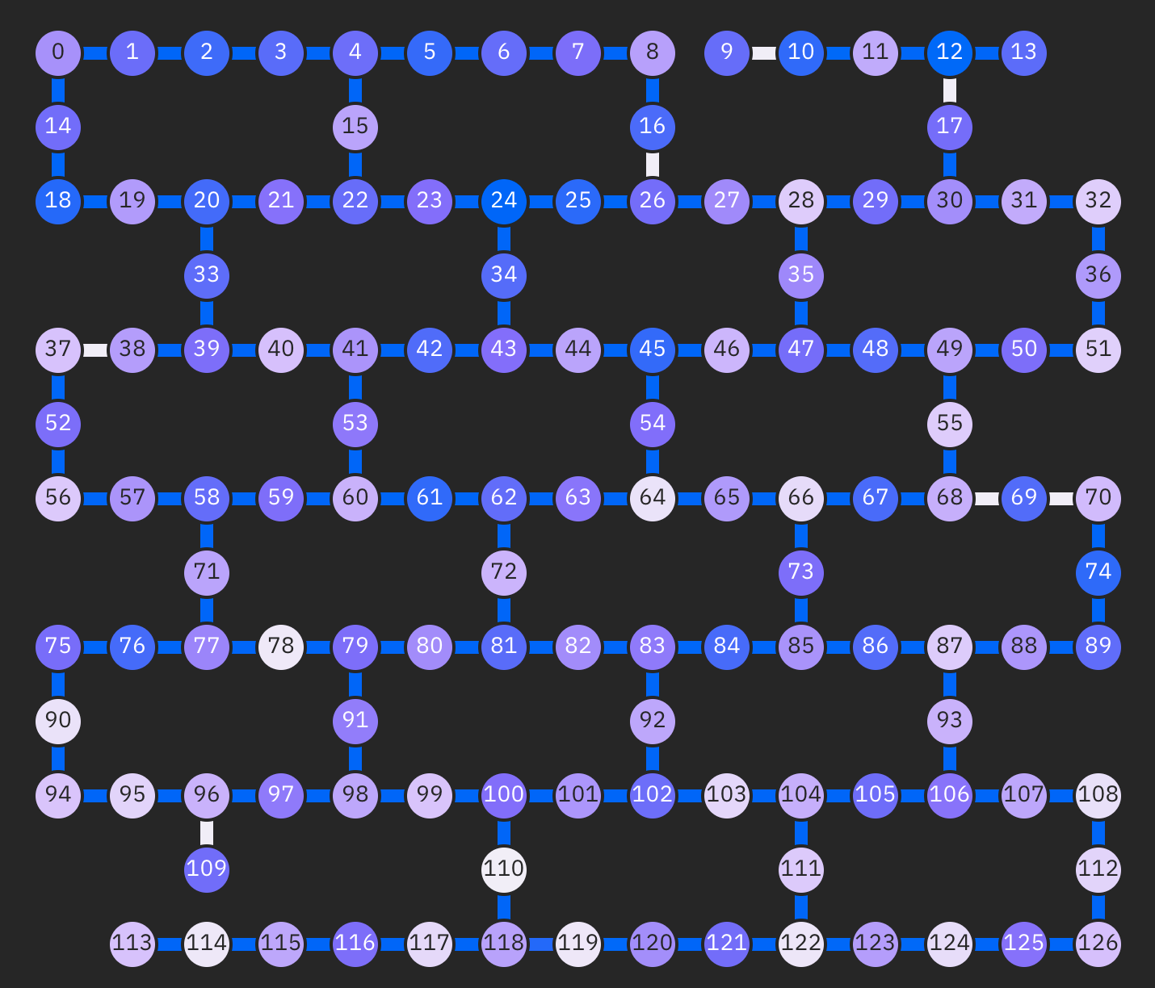
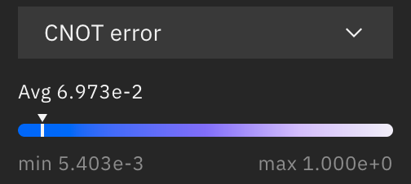
Quantum Computing in NISQ Era
Noisy Intermediate-Scale Quantum (NISQ)
Noisy: qubits are sensitive to environment; quantum gates are unreliable
Limited number of qubits: tens to hundreds of qubits
Limited connectivity: no all-to-all connections
Google Sycamore 53Q
IBM Washington 127Q
IBMQ Gate Error Rate
https://www.nature.com/articles/s41586-019-1666-5
https://quantum-computing.ibm.com/
https://quantum-computing.ibm.com/
Notes:
Despite of the exciting progress, we will still be in the NISQ era for several year in which we have noisy qubit and limited qubit numbers

Slide 5
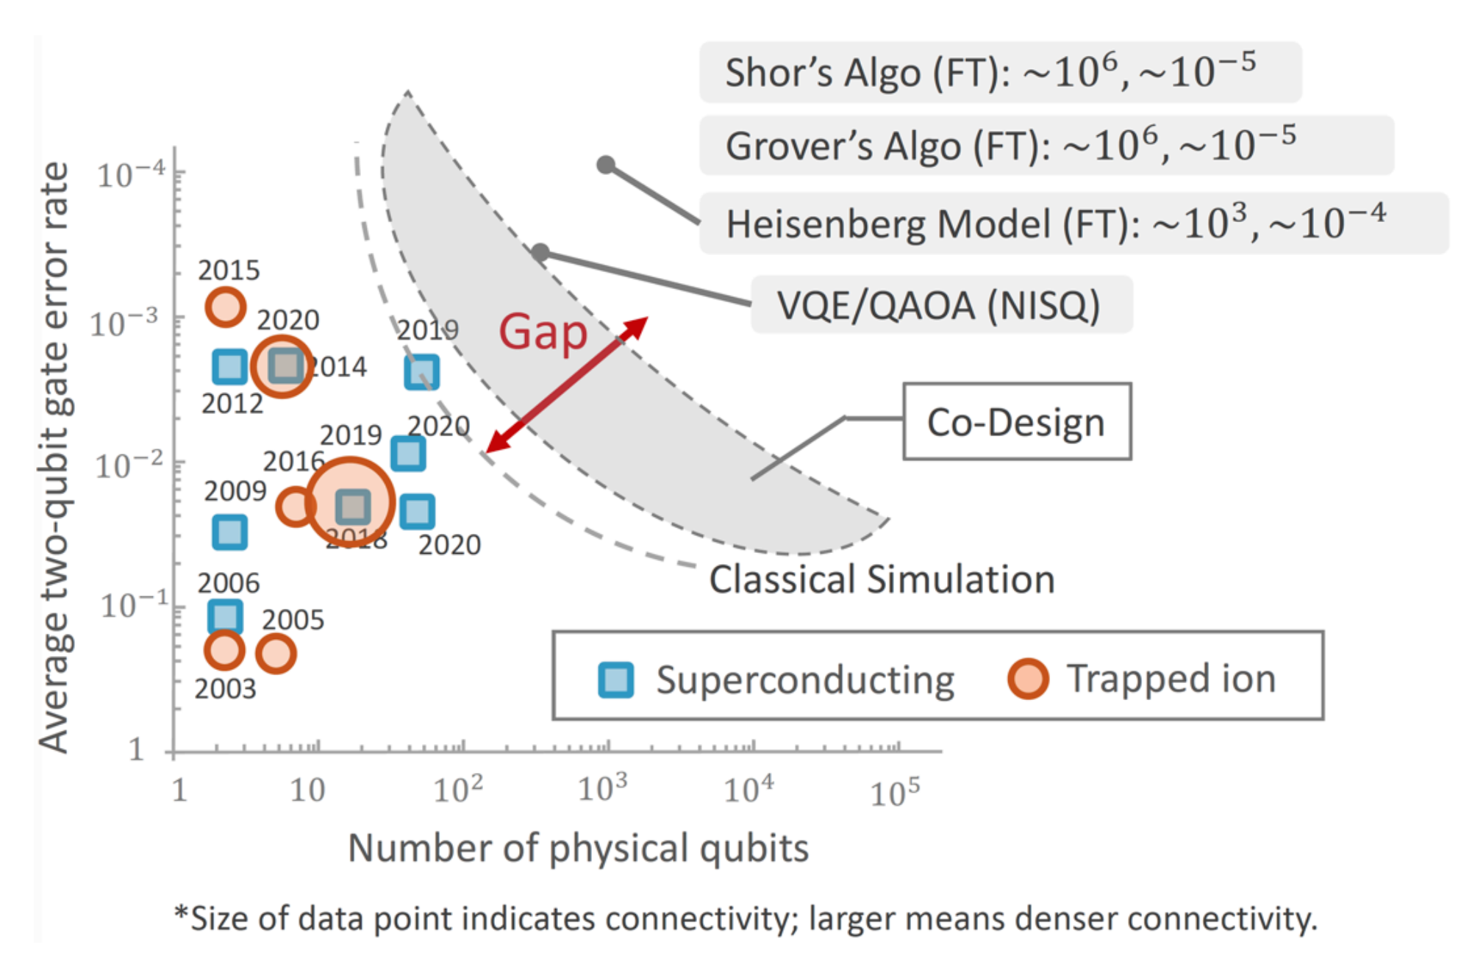
A Large Gap between Powerful Quantum Algorithms and Current Devices
Close the gap with machine learning and hardware-aware algorithm design
Fred Chong, https://indico.fnal.gov/event/47147/attachments/138920/174186/Chong-JTFI-2021.pdf18.pdf
Notes:
Our lab focus on the intersection of machine learning and quantum computing
We want to close the gap with ML and codesign of quantum algorithm and hardware
For example, we can use ML to optimize the circuit architecture, use ML to predict the noise drift and then mitigate, codesign the qubit mapping and circuit architecture aware of real quantum noise etc.

Slide 6
Good Infrastructure is Critical
To enable ML-assisted hardware-aware quantum algorithm design
Need a simulation framework on classical computer
Fast
PyTorch native
Portable
Scalable
Analyze circuit behavior
Study noise impact
Develop ML model for quantum optimization

Slide 7
TorchQuantum Library
A fast library for classical simulation of quantum circuit in PyTorch
Automatic gradient computation for training parameterized quantum circuit
GPU-accelerated tensor processing with batch mode support
Dynamic computation graph for easy debugging
Easy construction of hybrid classical and quantum neural networks
Gate level and pulse level simulation support
Converters to other frameworks such as IBM Qiskit
And so on…

Slide 8

TorchQuantum Tutorial Outline
Section 1
Section 2
Section 3
TorchQuantum Basic Usage
Use TorchQuantum on Gate Level Optimization
Use TorchQuantum on Pulse Level Optimization
1.1 Quantum Basics
2.1 QuantumNAS: Ansatz Search and Gate Pruning
1.2 TQ Operations
3.1 Quantum Optimal Control
2.2 QuantumNAT: Noise Injection and Quantization
1.3 TQ for State Prep
2.3 QOC: On-Chip Training
3.2 Variational Pulse Learning
1.4 TQ for VQE
2.4 Transformer for Quantum Circuit Reliability Prediction
1.5 TQ for QNN
2.5 QNN Compression

Slide 9
TorchQuantum Tutorial Outline
Section 1
Section 2
Section 3
TorchQuantum Basic Usage
Use TorchQuantum on Gate level
Use TorchQuantum on Pulse level
1.1 Quantum Basics
2.1 QuantumNAS: Ansatz Search and Gate Pruning
1.2 TQ Operations
3.1 Quantum Optimal Control
2.2 QuantumNAT: Noise Injection and Quantization
1.3 TQ for State Prep
2.3 QOC: On-Chip Training
3.2 Variational Pulse Learning
1.4 TQ for VQE
2.4 Transformer for Quantum Circuit Reliability Prediction
1.5 TQ for QNN
2.5 QNN Compression

Slide 10
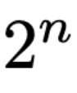
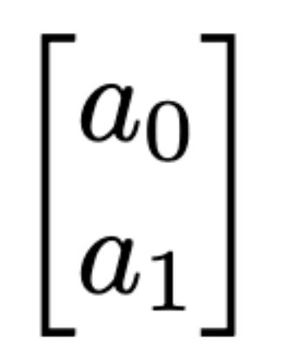
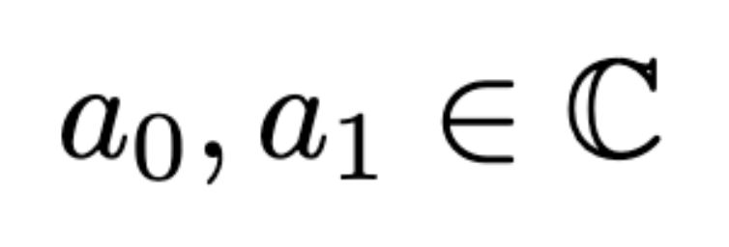
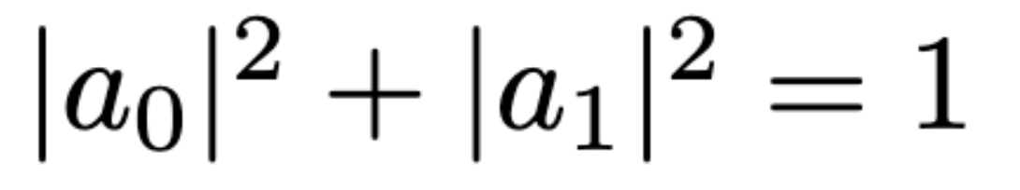
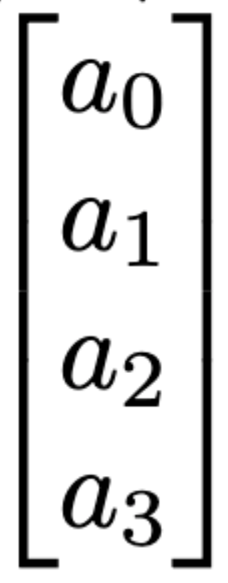
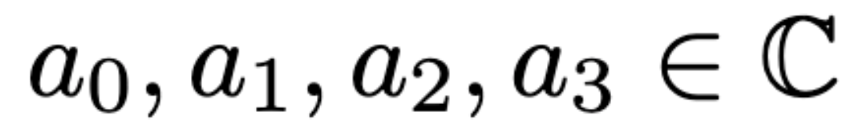
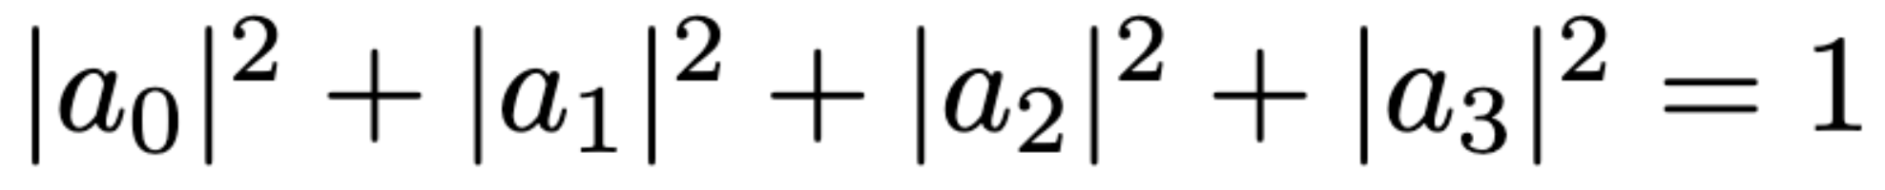
Quantum Bit
Quantum Bit (Qubit)
Statevector: contains complex numbers for n qubit system
The square sum of magnitude of numbers are 1
1 qubit:
2 qubits:

Slide 11
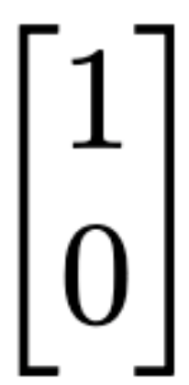

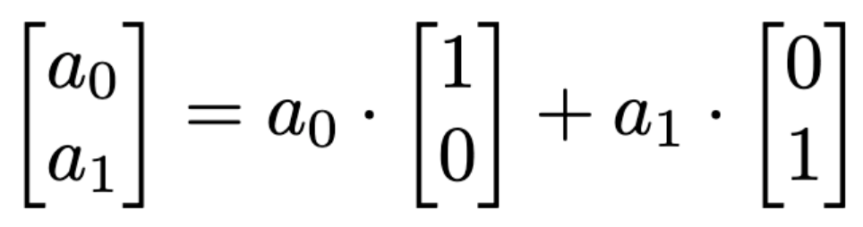
Quantum Bit
Classical bits represented in statevector
Classical 0:
Classical 1:
An arbitrary quantum states:

Slide 12
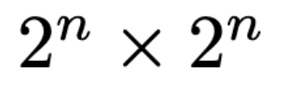
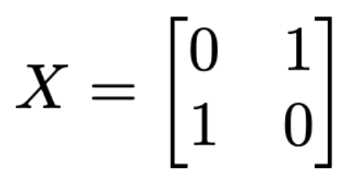
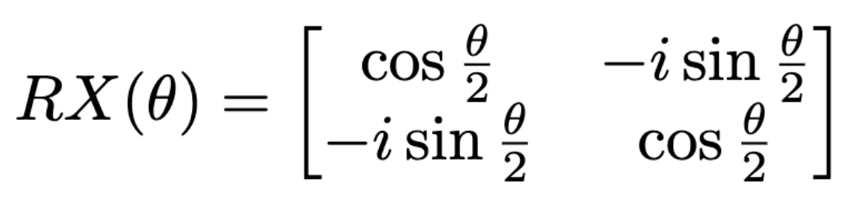
Quantum Gates
Qubit gates: operations on one qubit or multiple qubits
The qubit gates can be represented with matrix format with dimension
All gate matrices are unitary matrices: the conjugate transpose is the same as its inverse
Single qubit gates:
Not (X) gate:
Parameterized gate: Rotation X (RX) with parameter theta

Slide 13
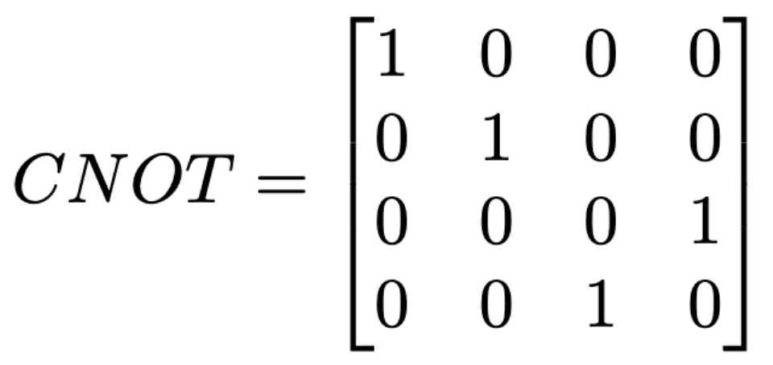
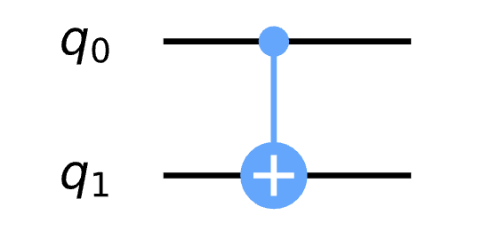
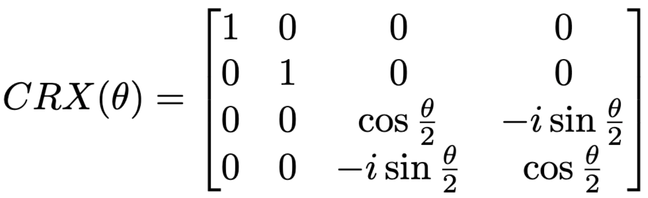
Quantum Gates
2-qubit gates:
Controlled Not (CNOT) gate:
Controlled Rotation X (CRX) gate
Output
Input
00
01
10
11
00
Control
01
Target
10
11

Slide 14
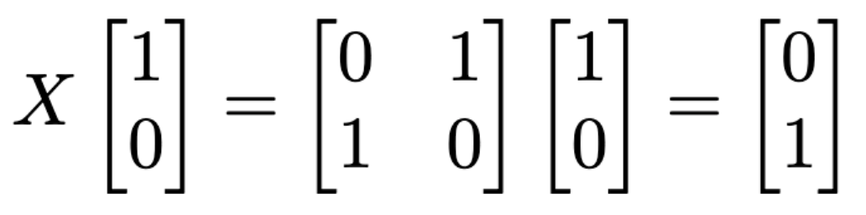
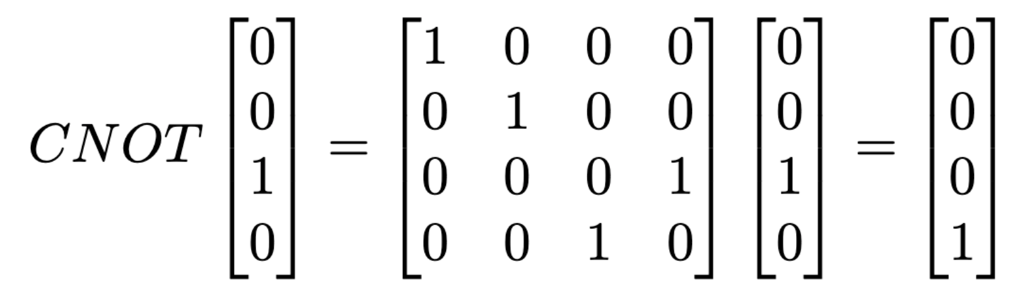
Quantum Gates
Applying a gate to qubits is performing matrix-vector multiplication between the gate matrix and statevector
Apply an X gate to classical state 0, we get 1
Apply an CNOT gate to state 10, we get 11

Slide 15
TorchQuantum Tutorial Outline
Section 1
Section 2
Section 3
TorchQuantum Basic Usage
Use TorchQuantum on Gate level
Use TorchQuantum on Pulse level
1.1 Quantum Basics
2.1 QuantumNAS: Ansatz Search and Gate Pruning
1.2 TQ operations
3.1 Quantum Optimal Control
2.2 QuantumNAT: Noise Injection and Quantization
1.3 TQ for State Prep
2.3 QOC: On-Chip Training
3.2 Variational Pulse Learning
1.4 TQ for VQE
2.4 Transformer for Quantum Circuit Reliability Prediction
1.5 TQ for QNN
2.5 QNN Compression

Slide 16
TQ for Statevector simulation
Performing matrix-vector multiplication between the gate matrix and statevector
The tq.QuantumDevice stores the statevectors
q_dev = tq.QuantumDevice(n_wires=5)
Two ways of applying quantum gates: method 1:
import torchquantum.functional as tqf
tqf.h(q_dev, wires=1)

Slide 17
TQ for Statevector simulation
Performing matrix-vector multiplication between the gate matrix and statevector
The tq.QuantumDevice stores the statevectors
q_dev = tq.QuantumDevice(n_wires=5)
Two ways of applying quantum gates: method 2:
h_gate = tq.H()
h_gate(q_dev, wires=3)

Slide 18
TQ for Statevector simulation
Performing matrix-vector multiplication between the gate matrix and statevector
The tq.QuantumState class can also store the statevectors
q_state = tq.QuantumState(n_wires=5)
Three ways of applying quantum gates
import torchquantum.functional as tqf
tqf.h(q_state, wires=1)
h_gate = tq.H()
h_gate(q_state)
q_state.h()
q_state.rx(wires=1, params=0.2 * np.pi)

Slide 19
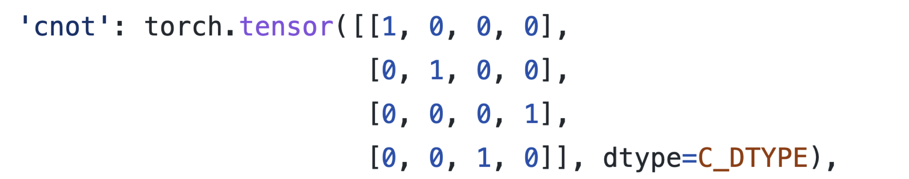
TQ for Statevector simulation
Performing matrix-vector multiplication between the gate matrix and statevector
The implementation of statevector and quantum gates are using the native data structure in PyTorch

Slide 20
Dynamic computation graph
Performing matrix-vector multiplication between the gate matrix and statevector
The tq.QuantumState class can also store the statevectors
q_state = tq.QuantumState(n_wires=5)
q_state.h(wires=1)
print(q_state)
q_state.sx(wires=3)
print(q_state)

Slide 21
Batch Mode Tensorized Processing
Performing matrix-vector multiplication between the gate matrix and statevector
The tq.QuantumState class can also store the statevectors
q_state = tq.QuantumState(n_wires=5, bsz=64)

Slide 22
GPU Support
Performing matrix-vector multiplication between the gate matrix and statevector
The tq.QuantumState class can also store the statevectors
q_state = tq.QuantumState(n_wires=5, bsz=64)
q_state.to(torch.device(‘cuda’))
Leverage the fast GPU support

Slide 23
Automatic Gradient Computation
Performing matrix-vector multiplication between the gate matrix and statevector
The tq.QuantumState class can also store the statevectors
q_state = tq.QuantumState(n_wires=2)
target_quantum_state = torch.tensor([0, 0, 0, 1])
loss = 1 - (q_state.get_states_1d()[0] @ target_quantum_state).abs()
loss.backward()

Slide 24
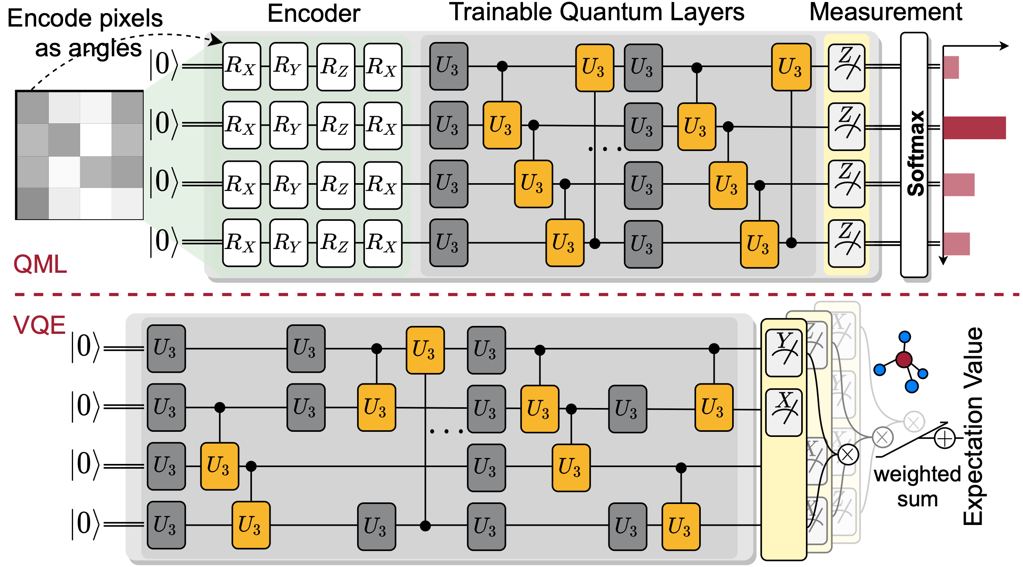
Encoding Classical Data to Quantum various encoder support
tq.AmplitudeEncoder() encodes the classical values to the amplitude of quantum statevector
tq.PhaseEncoder() encodes the classical values using the rotation gates

Slide 25
Construct a Circuit Class
Construct a class for circuit model
tq.QuantumModule class
In the __init__ function, create all the gates that will be used
In the forward function, specify how the gates will be used in the circuit
Class q_model(tq.QuantumModule) def __init__(): self.n_wires = 2 self.rx_0 = tq.RX(has_params=True, trainable=True) self.ry_0 = tq.RY(has_params=True, trainable=True) def forward(q_dev): self.rx_0(q_dev) self.ry_0(q_dev)

Slide 26
Conversion tq model to other frameworks
Convert the tq.QuantumModule to other frameworks such as Qiskit
from torchquantum.plugins.qiskit_plugin import tq2qiskit
circ = tq2qiskit(q_dev, q_model)
circ.draw('mpl')

Slide 27
Easy Deployment on Real Quantum Machines
Convert the tq.QuantumModule to other frameworks such as Qiskit
from torchquantum.plugins.qiskit_plugin import tq2qiskit
from torchquantum.plugins.qiskit_processor import QiskitProcessor
processor = QiskitProcessor(use_real_qc=False, max_jobs=1)
circ = tq2qiskit(q_dev, model)
circ.measure_all()
res = processor.process_ready_circs(q_dev, [circ])

Slide 28
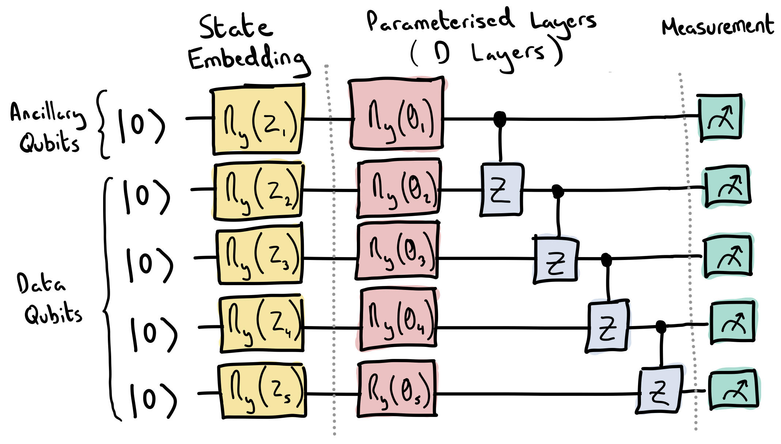
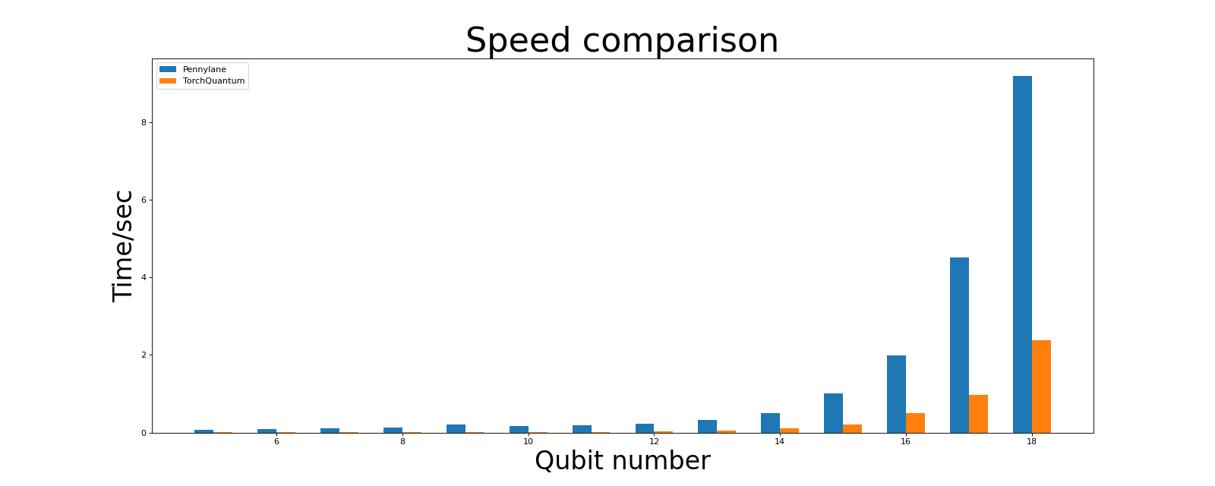
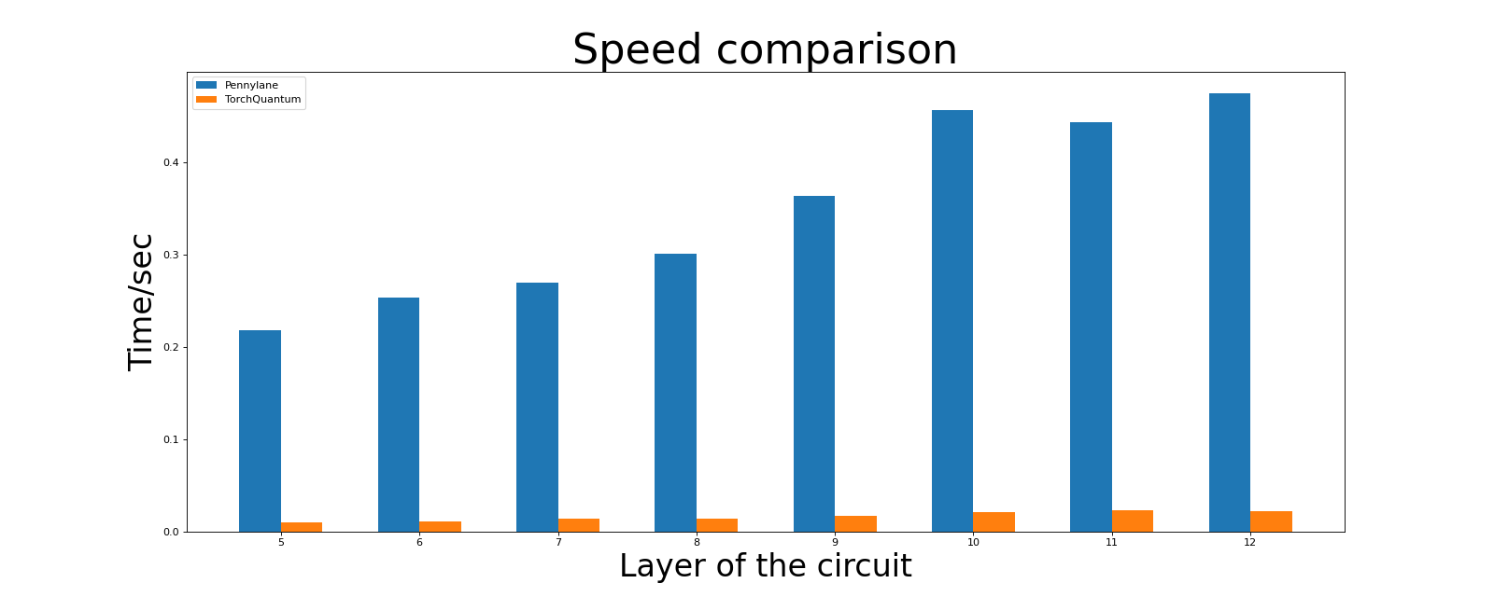
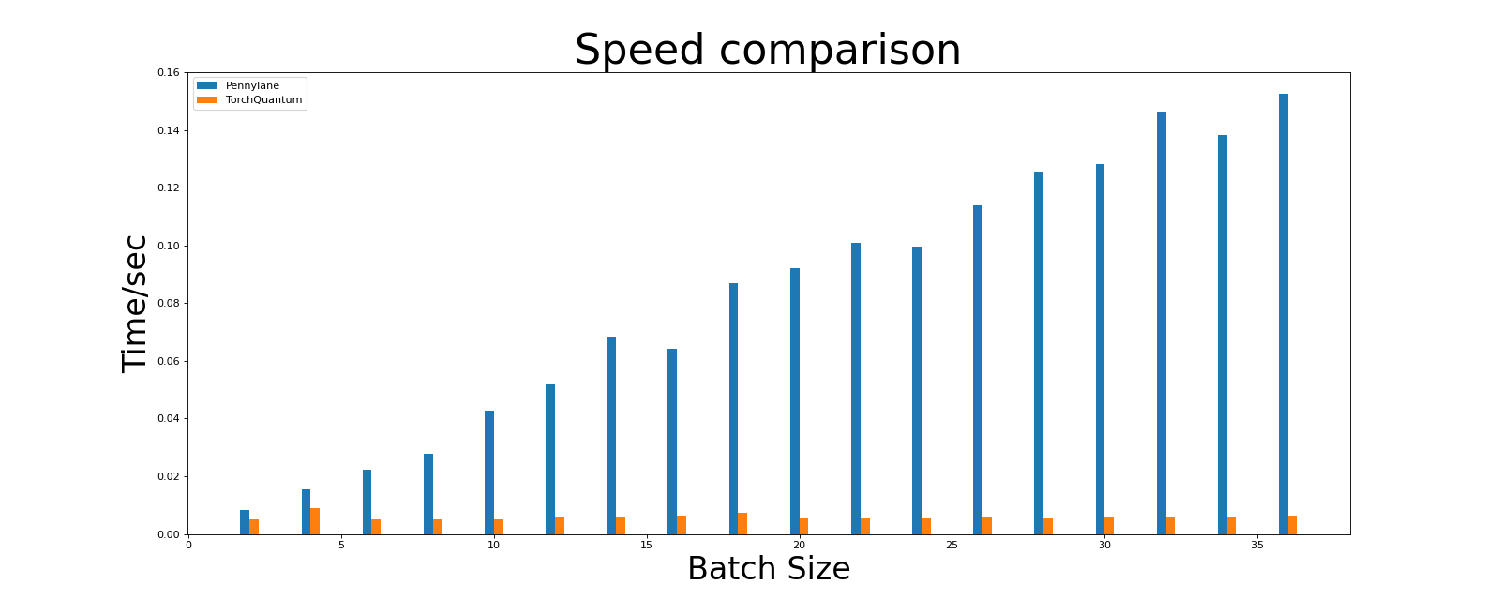
Compare the Speed of TQ and Pennylane
https://pennylane.ai/qml/_images/qcircuit.jpeg

Slide 29



Hands-On Section 1.2 TorchQuantum Operations

Slide 30
TorchQuantum Tutorial Outline
Section 1
Section 2
Section 3
TorchQuantum Basic Usage
Use TorchQuantum on Gate level
Use TorchQuantum on Pulse level
1.1 Quantum Basics
2.1 QuantumNAS: Ansatz Search and Gate Pruning
1.2 TQ operations
3.1 Quantum Optimal Control
2.2 QuantumNAT: Noise Injection and Quantization
1.3 TQ for State Prep
2.3 QOC: On-Chip Training
3.2 Variational Pulse Learning
1.4 TQ for VQE
2.4 Transformer for Quantum Circuit Reliability Prediction
1.5 TQ for QNN
2.5 QNN Compression

Slide 31
State Preparation with Parameterized Circuit
Use parameterized circuit to prepare initial quantum states
Circuit Ansatz

Slide 32
Hands-On Section 1.3 TQ for State Preparation

Slide 33
TorchQuantum Tutorial Outline
Section 1
Section 2
Section 3
TorchQuantum Basic Usage
Use TorchQuantum on Gate level
Use TorchQuantum on Pulse level
1.1 Quantum Basics
2.1 QuantumNAS: Ansatz Search and Gate Pruning
1.2 TQ operations
3.1 Quantum Optimal Control
2.2 QuantumNAT: Noise Injection and Quantization
1.3 TQ for State Prep
2.3 QOC: On-Chip Training
3.2 Variational Pulse Learning
1.4 TQ for VQE
2.4 Transformer for Quantum Circuit Reliability Prediction
1.5 TQ for QNN
2.5 QNN Compression

Slide 34
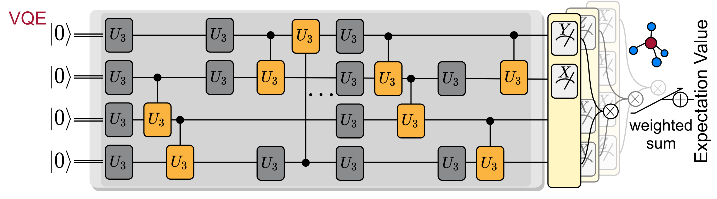
Variational Quantum Eigensolver
VQE: Finds the ground state energy of molecule Hamiltonian

Slide 35
Hands-On Section 1.4 TQ for VQE

Slide 36
TorchQuantum Tutorial Outline
Section 1
Section 2
Section 3
TorchQuantum Basic Usage
Use TorchQuantum on Gate level
Use TorchQuantum on Pulse level
1.1 Quantum Basics
2.1 QuantumNAS: Ansatz Search and Gate Pruning
1.2 TQ operations
3.1 Quantum Optimal Control
2.2 QuantumNAT: Noise Injection and Quantization
1.3 TQ for State Prep
2.3 QOC: On-Chip Training
3.2 Variational Pulse Learning
1.4 TQ for VQE
2.4 Transformer for Quantum Circuit Reliability Prediction
1.5 TQ for QNN
2.5 QNN Compression

Slide 37
Quantum Neural Networks for MNIST Classification
Encode the classical values using phase encoding
Then trainable quantum layers
Finally measurement layers

Slide 38
Hands-On Section 1.5 TQ for QNN

Slide 39
TorchQuantum Tutorial Outline
Section 1
Section 2
Section 3
TorchQuantum Basic Usage
Use TorchQuantum on Gate level
Use TorchQuantum on Pulse level
1.1 Quantum Basics
2.1 QuantumNAS: Ansatz Search and Gate Pruning
1.2 TQ operations
3.1 Quantum Optimal Control
2.2 QuantumNAT: Noise Injection and Quantization
1.3 TQ for State Prep
2.3 QOC: On-Chip Training
3.2 Variational Pulse Learning
1.4 TQ for VQE
2.4 Transformer for Quantum Circuit Reliability Prediction
1.4 TQ for QNN
2.5 QNN Compression

Slide 40
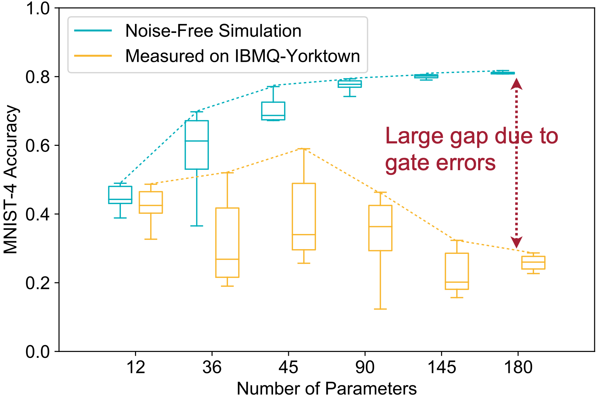
Challenges of PQC — Noise
Noise degrades PQC reliability
More parameters increase the noise-free accuracy but degrade the measured accuracy
Therefore, circuit architecture is critical
Notes:
However, PQC has two major challenges. Firstly, the quantum noise degrades the PQC reliability. The figures below shows the MNIST-4 image classification accuracy using QNN with different number of parameters.
We find that more parameters can increase the noise-free accuracy in green but may degrade the measured accuracy in yellow. Also, under the same number of parameters, the measured accuracy of different circuit architecture (or called ansatz) varies a lot. Therefore it is critical to design noise-robust circuit architecture.

Slide 41
Challenges of PQC — Large Design Space
Large design space for circuit architecture
Type of gates
⎥0〉
U3
CU3
⎥0〉
X
CZ
⎥0〉
U3
CU3
⎥0〉
X
CZ
⎥0〉
U3
CU3
⎥0〉
X
CZ
⎥0〉
U3
CU3
⎥0〉
X
CZ
Notes:
Another challenge is the large design space of PQC. For example, we can select different types of gates, such as U3 CU3 or X and CZ gates.

Slide 42
Challenges of PQC — Large Design Space
Large design space for circuit architecture
Type of gates
Number of gates
⎥0〉
U3
CU3
⎥0〉
X
CZ
⎥0〉
U3
CU3
⎥0〉
X
CZ
⎥0〉
U3
CU3
⎥0〉
X
CZ
⎥0〉
U3
CU3
⎥0〉
X
CZ
⎥0〉
U3
CU3
⎥0〉
U3
CU3
U3
CU3
⎥0〉
U3
CU3
⎥0〉
U3
CU3
U3
CU3
⎥0〉
U3
CU3
⎥0〉
U3
CU3
U3
CU3
⎥0〉
U3
CU3
⎥0〉
U3
CU3
U3
CU3
Notes:
We can also choose different number of gates.

Slide 43
Challenges of PQC — Large Design Space
Large design space for circuit architecture
Type of gates
Number of gates
Position of gates
⎥0〉
U3
CU3
⎥0〉
X
CZ
⎥0〉
U3
CU3
⎥0〉
X
CZ
⎥0〉
U3
CU3
⎥0〉
X
CZ
⎥0〉
U3
CU3
⎥0〉
X
CZ
⎥0〉
U3
CU3
⎥0〉
U3
CU3
U3
CU3
⎥0〉
U3
CU3
⎥0〉
U3
CU3
U3
CU3
⎥0〉
U3
CU3
⎥0〉
U3
CU3
U3
CU3
⎥0〉
U3
CU3
⎥0〉
U3
CU3
U3
CU3
⎥0〉
U3
CU3
U3
CU3
⎥0〉
⎥0〉
U3
CU3
CU3
U3
U3
⎥0〉
⎥0〉
U3
CU3
CU3
U3
⎥0〉
⎥0〉
U3
CU3
CU3
⎥0〉
Notes:
Even with the same number of gates, the positions of the gates can be very diverse. So the design space is huge.

Slide 44
Goal of QuantumNAS
Automatically & efficiently search for noise-robust quantum circuit
Train one “SuperCircuit”, providing parameters to many “SubCircuits”
(1) Quantum noise feedback in the search loop
(2) Co-search the circuit architecture and qubit mapping
Solve the challenge of large design space
Solve the challenge of large quantum noise
Notes:
The goal of quantumnas is to automatically and efficiency search for noise-robust quantum circuits.
The automatic and efficient search is achieved by the Supercircuit, which is train for once but used for many sub circuit candidates. The noise-robustness is achieved by involving the quantum noise feedback in the search loop and co-searching the circuit architecture and qubit mapping.

Slide 45
QuantumNAS
SuperCircuit Construction and Training
Noise-Adaptive Evolutionary Co-Search of SubCircuit and Qubit Mapping
Train the Searched SubCircuit
Iterative Quantum Gate Pruning
Notes:
Here are the four steps of Quantumnas.

Slide 46
QuantumNAS
SuperCircuit Construction and Training
Noise-Adaptive Evolutionary Co-Search of SubCircuit and Qubit Mapping
Train the Searched SubCircuit
Iterative Quantum Gate Pruning
Notes:
The first is SuperCircuit Construction and Training

Slide 47
SuperCircuit & SubCircuit
Firstly construct a design space. For example, a design space of maximum 4 U3 in the first layer and 4 CU3 gates in the second layer
Notes:
We firstly need to have a pre-defined design space. For example, we can have a design space with 4 U3 gates in the first layer and 4 CU3 gates in the second layer. So the design space contains 2^8 which is 256 candidates. If we train each of them with classical simulator on one Nvidia GPU, that will take around 100 hours which is very costly.

Slide 48
SuperCircuit & SubCircuit
Firstly construct a design space. For example, a design space of maximum 4 U3 in the first layer and 4 CU3 gates in the second layer
SuperCircuit: the circuit with the largest number of gates in the design space
Example: SuperCircuit in U3+CU3 space
⎥0〉
1
8
⎥0〉
2
5
⎥0〉
3
6
⎥0〉
4
7
Notes:
Therefore, we want to enable efficient search with the help of a super circuit. The super circuit is the circuit with the largest number of gates in the design space. Here is the example of the super circuit in U3+CU3 design space which contains 8 gates.

Slide 49
SuperCircuit & SubCircuit
Firstly construct a design space. For example, a design space of maximum 4 U3 in the first layer and 4 CU3 gates in the second layer
SuperCircuit: the circuit with the largest number of gates in the design space
Example: SuperCircuit in U3+CU3 space
Each candidate circuit in the design space (called SubCircuit) is a subset of the SuperCircuit
⎥0〉
1
8
⎥0〉
2
5
⎥0〉
3
6
⎥0〉
4
7
⎥0〉
8
⎥0〉
1
8
⎥0〉
⎥0〉
2
5
⎥0〉
5
2
5
⎥0〉
⎥0〉
3
6
⎥0〉
6
3
⎥0〉
⎥0〉
⎥0〉
7
4
7
⎥0〉
Notes:
SubCircuit is a subset of the super circuit gates. Here we show three examples of sub circuits. The first contains gate…
The second one… the circuit one ..

Slide 50
SuperCircuit Construction
Why use a SuperCircuit?
Enables efficient search of architecture candidates without training each
SubCircuit inherits parameters from SuperCircuit
With inherited parameters, we find some good SubCircuits, we find that they are also good SubCircuits with parameters trained from-scratch individually
Notes:
Since all subcircuits share the parameters of the supercircuit, we need to prevent interference of sub circuit from each other.

Slide 51
SuperCircuit Training
In one SuperCircuit Training step:
Sample a gate subset of SuperCircuit (a SubCircuit)
Front Sampling and Restricted Sampling
Only use the subset to perform the task and updates the parameters in the subset
Parameter updates are cumulative across steps
Notes:
Therefore, we perform super circuit training by iteratively sampling and updating subcircuits.
In one step, we use front sampling the restricted sampling to sample a sub circuit candidate, then use it do the inference and update its parameters.
Parameter updates are cumulative across steps

Slide 52
Front Sampling
During sampling, we first sample total number of blocks, then sample gates within each block
Front sampling: Only the front several blocks and front several gates can be sampled to make SuperCircuit training more stable
Sample front gates
Qubit 0 ⎥0〉
1
4
1
4
Qubit 1 ⎥0〉
2
1
…
2
1
Qubit 2 ⎥0〉
3
2
3
2
Qubit 3 ⎥0〉
4
3
4
3
Block 1
Block N
Notes:
For the super circuit, we can stack multiple blocks like this to enable larger number of gates and capacity.
During sampling, we first sample total number of blocks, then sample gates within each block. Front sampling means we only sample the front several blocks and front several gates. For example, if we sample two gates in one layer, then they will be gate 1 and gate two; if we sample only one gate in one layer, then that will be gate 1.

Slide 53
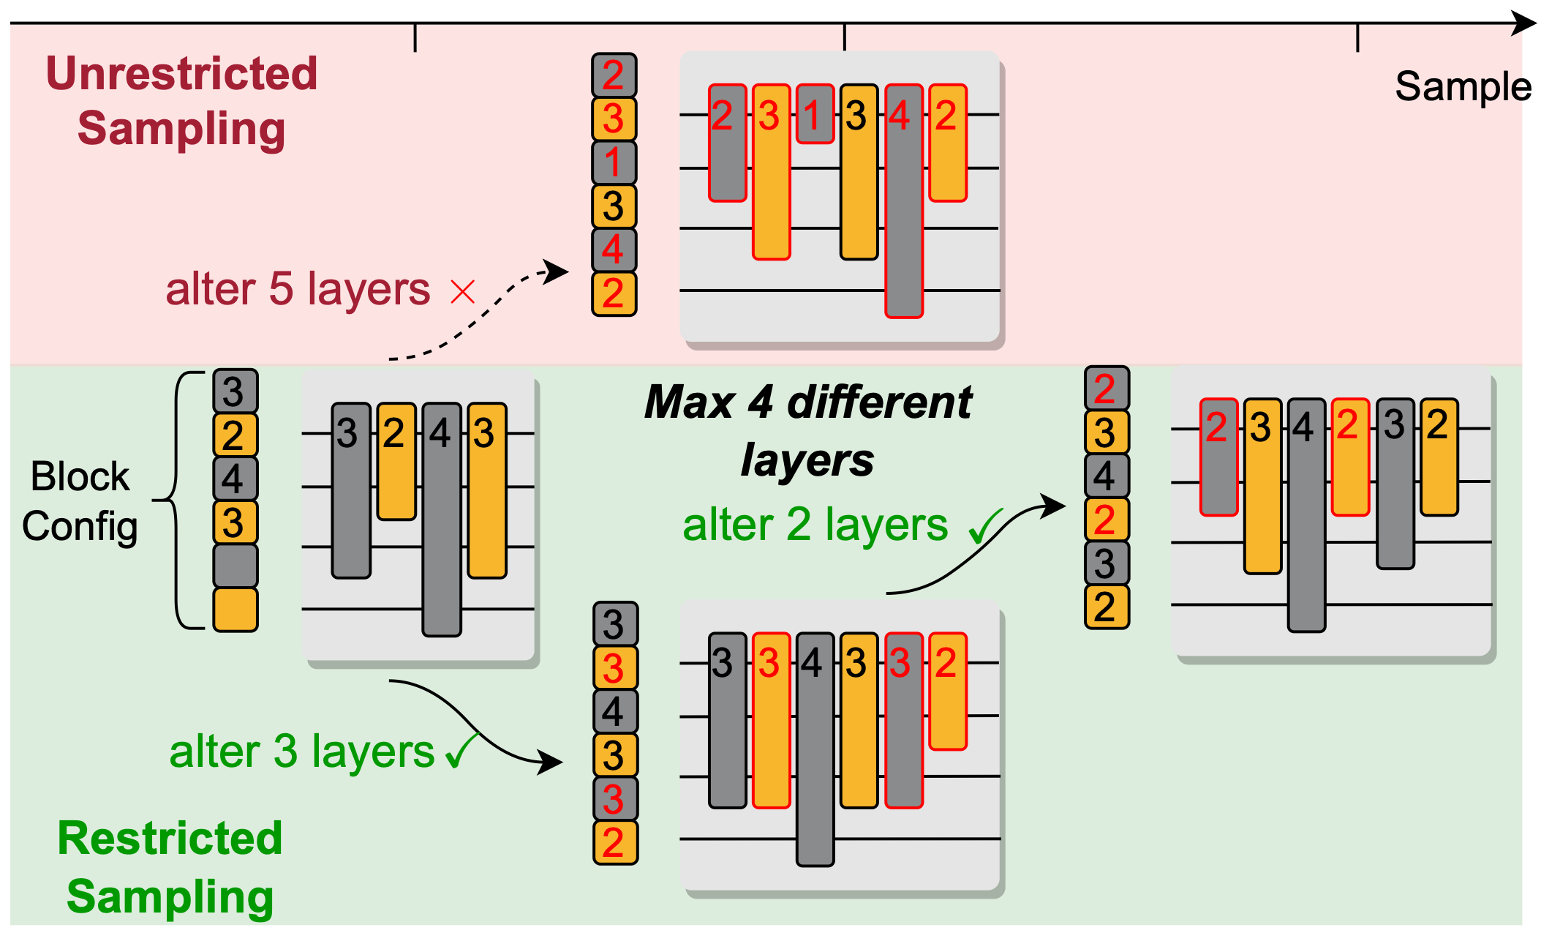
Restricted Sampling
Restricted Sampling:
Restrict the difference between SubCircuits of two consecutive steps
For example: restrict to at most 4 different layers
Notes:
We also propose restricted sampling. We restrict the difference between sub circuits of two consecutive steps. For example here we set the maximum different layer to be 4

Slide 54
Restricted Sampling
Restricted Sampling:
Restrict the difference between SubCircuits of two consecutive steps
For example: restrict to at most 4 different layers
Notes:
Then if we sample a circuit with 5 different layers as show at the top, we will discard it and resample. If the circuit has 3 different layers, we will use it such as the one at the bottom.

Slide 55
Restricted Sampling
Restricted Sampling:
Restrict the difference between SubCircuits of two consecutive steps
For example: restrict to at most 4 different layers
Notes:
For next step, in this example only two layers are different so we can use it.

Slide 56
Train SuperCircuit for Multiple Steps
In one SuperCircuit Training step: Sample and Train
Qubit 0 ⎥0〉
Qubit 1 ⎥0〉
…
Qubit 2 ⎥0〉
Qubit 3 ⎥0〉
Block 1
Block N
Notes:
With the front sampling and restricted sampling, we can perform sub circuit sampling and parameter training for many steps.

Slide 57
Train SuperCircuit for Multiple Steps
In one SuperCircuit Training step: Sample and Train
Qubit 0 ⎥0〉
Qubit 1 ⎥0〉
…
Qubit 2 ⎥0〉
Qubit 3 ⎥0〉
Block 1
Block N
Notes:
With the front sampling and restricted sampling, we can perform sub circuit sampling and parameter training for many steps.

Slide 58
Train SuperCircuit for Multiple Steps
In one SuperCircuit Training step: Sample and Train
Qubit 0 ⎥0〉
Qubit 1 ⎥0〉
…
Qubit 2 ⎥0〉
Qubit 3 ⎥0〉
Block 1
Block N
Notes:
With the front sampling and restricted sampling, we can perform sub circuit sampling and parameter training for many steps.

Slide 59
Train SuperCircuit for Multiple Steps
In one SuperCircuit Training step: Sample and Train
Qubit 0 ⎥0〉
Qubit 1 ⎥0〉
…
Qubit 2 ⎥0〉
Qubit 3 ⎥0〉
Block 1
Block N
Notes:
With the front sampling and restricted sampling, we can perform sub circuit sampling and parameter training for many steps.

Slide 60
Train SuperCircuit for Multiple Steps
In one SuperCircuit Training step: Sample and Train
Qubit 0 ⎥0〉
Qubit 1 ⎥0〉
…
Qubit 2 ⎥0〉
Qubit 3 ⎥0〉
Block 1
Block N
Notes:
With the front sampling and restricted sampling, we can perform sub circuit sampling and parameter training for many steps.

Slide 61
Train SuperCircuit for Multiple Steps
In one SuperCircuit Training step: Sample and Train
Qubit 0 ⎥0〉
Qubit 1 ⎥0〉
…
Qubit 2 ⎥0〉
Qubit 3 ⎥0〉
Block 1
Block N
Notes:
With the front sampling and restricted sampling, we can perform sub circuit sampling and parameter training for many steps.

Slide 62
Train SuperCircuit for Multiple Steps
In one SuperCircuit Training step: Sample and Train
Qubit 0 ⎥0〉
Qubit 1 ⎥0〉
…
Qubit 2 ⎥0〉
Qubit 3 ⎥0〉
Block 1
Block N
Notes:
With the front sampling and restricted sampling, we can perform sub circuit sampling and parameter training for many steps.

Slide 63
Train SuperCircuit for Multiple Steps
In one SuperCircuit Training step: Sample and Train
Qubit 0 ⎥0〉
Qubit 1 ⎥0〉
…
Qubit 2 ⎥0〉
Qubit 3 ⎥0〉
Block 1
Block N
Notes:
With the front sampling and restricted sampling, we can perform sub circuit sampling and parameter training for many steps.

Slide 64
Train SuperCircuit for Multiple Steps
In one SuperCircuit Training step: Sample and Train
Qubit 0 ⎥0〉
Qubit 1 ⎥0〉
…
Qubit 2 ⎥0〉
Qubit 3 ⎥0〉
Block 1
Block N
Notes:
With the front sampling and restricted sampling, we can perform sub circuit sampling and parameter training for many steps.

Slide 65
Train SuperCircuit for Multiple Steps
In one SuperCircuit Training step: Sample and Train
Qubit 0 ⎥0〉
Qubit 1 ⎥0〉
…
Qubit 2 ⎥0〉
Qubit 3 ⎥0〉
Block 1
Block N
Notes:
With the front sampling and restricted sampling, we can perform sub circuit sampling and parameter training for many steps.

Slide 66
Train SuperCircuit for Multiple Steps
In one SuperCircuit Training step: Sample and Train
Qubit 0 ⎥0〉
Qubit 1 ⎥0〉
…
Qubit 2 ⎥0〉
Qubit 3 ⎥0〉
Block 1
Block N
Notes:
With the front sampling and restricted sampling, we can perform sub circuit sampling and parameter training for many steps.

Slide 67
Train SuperCircuit for Multiple Steps
In one SuperCircuit Training step: Sample and Train
Qubit 0 ⎥0〉
Qubit 1 ⎥0〉
…
Qubit 2 ⎥0〉
Qubit 3 ⎥0〉
Block 1
Block N
Notes:
With the front sampling and restricted sampling, we can perform sub circuit sampling and parameter training for many steps.

Slide 68
Train SuperCircuit for Multiple Steps
In one SuperCircuit Training step: Sample and Train
Qubit 0 ⎥0〉
Qubit 1 ⎥0〉
…
Qubit 2 ⎥0〉
Qubit 3 ⎥0〉
Block 1
Block N
Notes:
With the front sampling and restricted sampling, we can perform sub circuit sampling and parameter training for many steps.

Slide 69
Train SuperCircuit for Multiple Steps
In one SuperCircuit Training step: Sample and Train
Qubit 0 ⎥0〉
Qubit 1 ⎥0〉
…
Qubit 2 ⎥0〉
Qubit 3 ⎥0〉
Block 1
Block N
Notes:
With the front sampling and restricted sampling, we can perform sub circuit sampling and parameter training for many steps.

Slide 70
Train SuperCircuit for Multiple Steps
In one SuperCircuit Training step: Sample and Train
Qubit 0 ⎥0〉
Qubit 1 ⎥0〉
…
Qubit 2 ⎥0〉
Qubit 3 ⎥0〉
Block 1
Block N
Notes:
With the front sampling and restricted sampling, we can perform sub circuit sampling and parameter training for many steps.

Slide 71
Train SuperCircuit for Multiple Steps
Qubit 0 ⎥0〉
0.1
Qubit 1 ⎥0〉
0.2
…
Qubit 2 ⎥0〉
0.9
Qubit 3 ⎥0〉
1.1
Block 1
Block N
Qubit 0 ⎥0〉
0.2
Qubit 1 ⎥0〉
-0.1
…
Qubit 2 ⎥0〉
1.4
Qubit 3 ⎥0〉
1.1
Block 1
Block N
Qubit 0 ⎥0〉
0.4
Qubit 1 ⎥0〉
-0.1
…
Qubit 2 ⎥0〉
1.4
Qubit 3 ⎥0〉
1.1
Block 1
Block N
Notes:
With the front sampling and restricted sampling, we can perform sub circuit sampling and parameter training for many steps.

Slide 72
How Reliable is the SuperCircuit?
Inherited parameters from SuperCircuit can provide accurate relative performance
Spearman Corr.:
0.79
Spearman Corr.:
0.91
U3+CU3
MNIST-4
U3+CU3
Fashion-4
Spearman Corr.:
0.76
Spearman Corr.:
0.78
Y-axis: SubCircuit Performance trained from Scratch
ZZ+RY
MNIST-4
ZZ+RY
Fashion-4
X-axis: SubCircuit Performance with Inherted Parameters from SuperCircuit
Notes:
Here we show the reliability of supercircut. The x-axis is SubCircuit Performance with Inherted Parameters from SuperCircuit, y-axis is SubCircuit Performance trained from Scratch. We can see a clear positive correlation between them with a spearman correlation around 0.8. so the inherited parameters are reliable enough to indicate the final performance.

Slide 73
QuantumNAS
SuperCircuit Construction and Training
Noise-Adaptive Evolutionary Co-Search of SubCircuit and Qubit Mapping
Train the Searched SubCircuit
Iterative Quantum Gate Pruning
Notes:
Then we obtain the trained super circuit and enter the next step

Slide 74
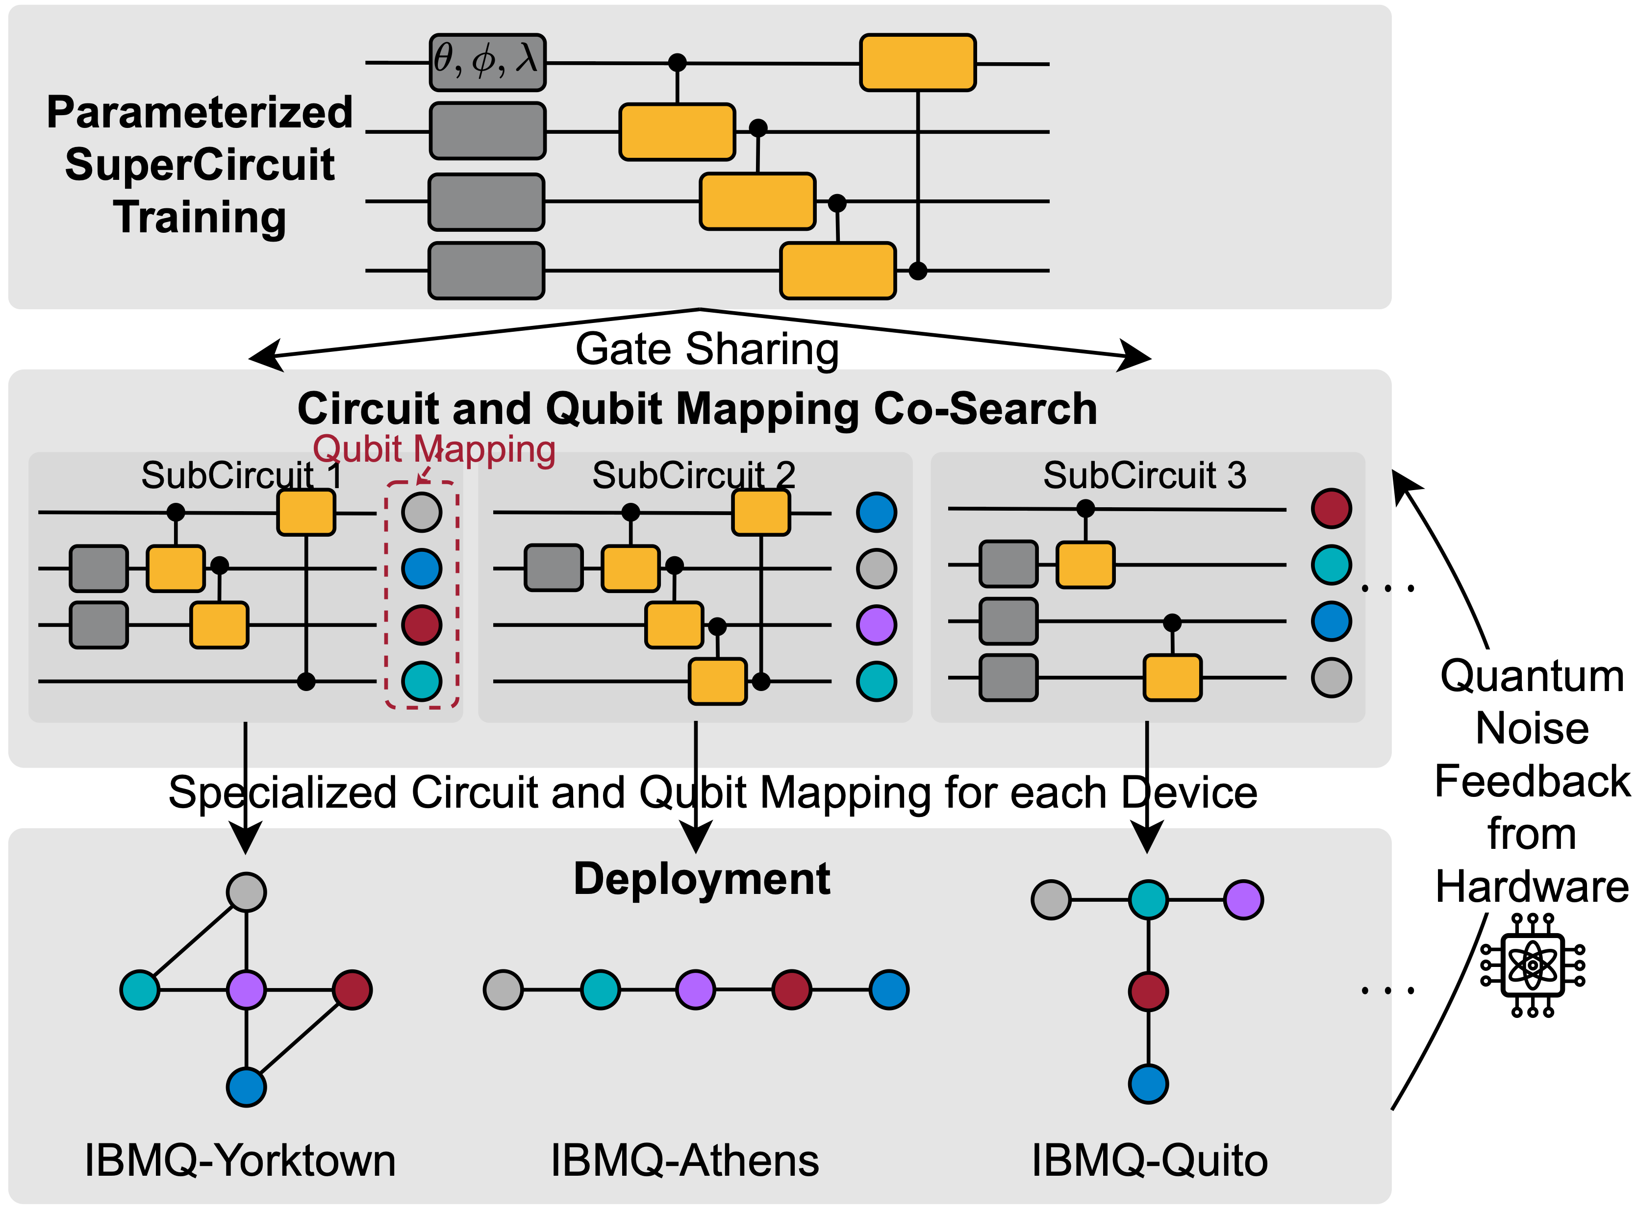
Noise-Adaptive Evolutionary Co-Search
Search the best SubCircuit and its qubit mapping on target device
Notes:
We can use the super circuit to perform efficient noise-adaptive search of sub circuit architecture and qubit mapping on target device such as IBMQ Yorktown.

Slide 75
Noise-Adaptive Evolutionary Co-Search
Search the best SubCircuit and its qubit mapping on target device
⎥0〉
⎥0〉
⎥0〉
⎥0〉
⎥0〉
⎥0〉
⎥0〉
⎥0〉
⎥0〉
⎥0〉
⎥0〉
⎥0〉
Evolutionary Search Engine
Mutation Crossover
Parameters from SuperCircuit
Simulate with noise model
Or
Directly run on real QC device
SubCircuit and Qubit Mapping pairs
Notes:
We use the evolution search as the optimization engine. In one iteration, it generates sub circuit architecture and qubit mapping pairs. Those pairs are then evaluated. The parameters are inherited from super circuit with no need for training, then the performance is simulated with noise model or directly run on real QC devices. Here is where the noise information is involved.

Slide 76
Noise-Adaptive Evolutionary Co-Search
Search the best SubCircuit and its qubit mapping on target device
⎥0〉
⎥0〉
⎥0〉
⎥0〉
⎥0〉
⎥0〉
⎥0〉
⎥0〉
⎥0〉
⎥0〉
⎥0〉
⎥0〉
Evolutionary Search Engine
Mutation Crossover
Parameters from SuperCircuit
Simulate with noise model
Or
Directly run on real QC device
SubCircuit and Qubit Mapping pairs
Performance of SubCircuit and Qubit Mapping pairs
Notes:
The performance is then sent back to the evolutionary search engine and the pairs with high performance are selected as parents and new population is generated by mutation and crossover.

Slide 77
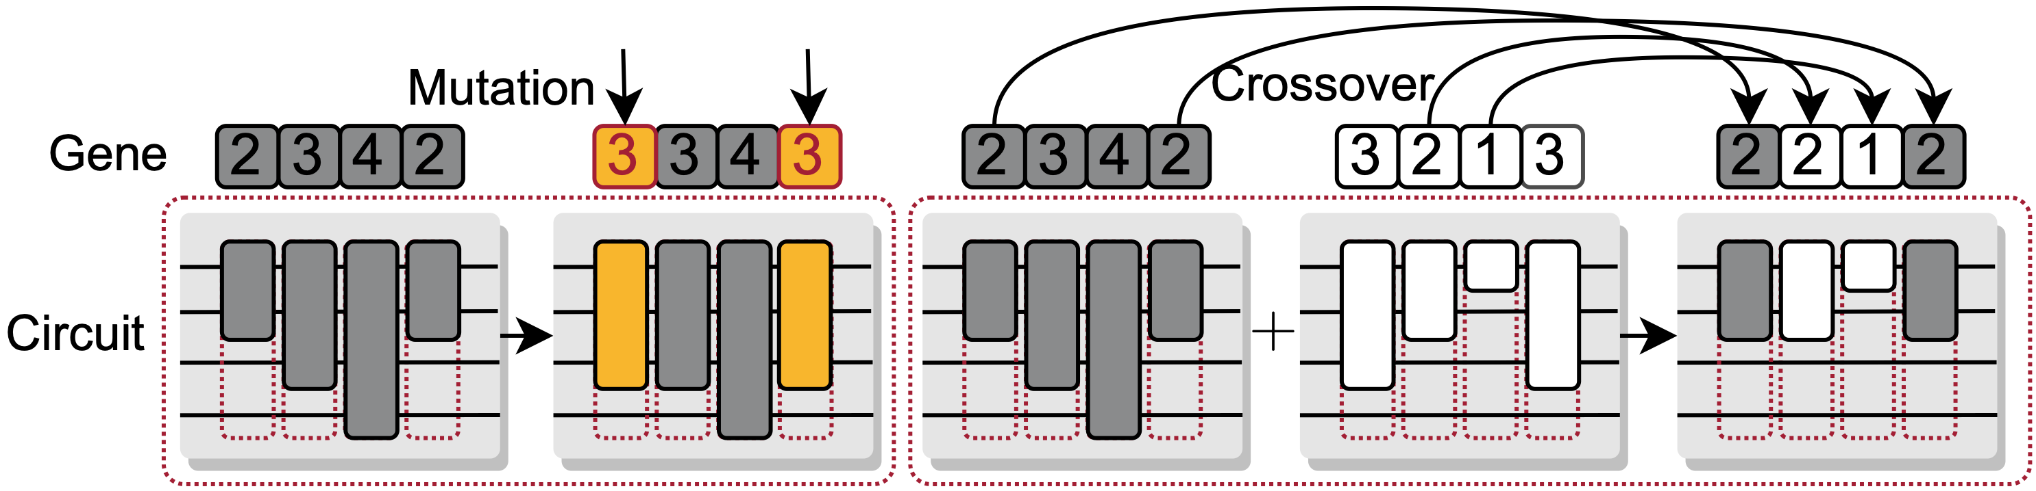
Mutation and Crossover
Mutation and crossover create new SubCircuit candidates
Notes:
For mutation, we directly alter the architecture of several layers with a probability. For crossover, we select two parents and generate new sub circuit by assembling part of circuit architecture of two parents.

Slide 78
QuantumNAS
SuperCircuit Construction and Training
Noise-Adaptive Evolutionary Co-Search of SubCircuit and Qubit Mapping
Train the Searched SubCircuit
Iterative Quantum Gate Pruning
Notes:
After multiple iterations, we can obtain the searched sub circuit architecture and qubit mapping, so we can train the sub circuit from scratch.

Slide 79
QuantumNAS
SuperCircuit Construction and Training
Noise-Adaptive Evolutionary Co-Search of SubCircuit and Qubit Mapping
Train the Searched SubCircuit
Iterative Quantum Gate Pruning
Notes:
Then we can further perform the iterative quantum gate pruning on the trained sub circuit.

Slide 80
Iterative Pruning
Some gates have parameters close to 0
Rotation gate with angle close to 0 has small impact on the results
Iteratively prune small-magnitude gates and fine-tune the remaining parameters
Qubit 0 ⎥0〉
Qubit 1 ⎥0〉
…
Qubit 2 ⎥0〉
Qubit 3 ⎥0〉
Block 1
Block N
Notes:
Specifically, since some gates contain parameters very close to zero, they have small impact to the results. Therefore, we can iteratively prune small-magnitude gates and fine-tune the remaining gate parameters like this.

Slide 81
Iterative Pruning
Some gates have parameters close to 0
Rotation gate with angle close to 0 has small impact on the results
Iteratively prune small-magnitude gates and fine-tune the remaining parameters
Qubit 0 ⎥0〉
Qubit 1 ⎥0〉
0
…
Qubit 2 ⎥0〉
Qubit 3 ⎥0〉
Block 1
Block N
Notes:
Through fine-tuning, the noise-free accuracy can be recovered. Since fewer gates brings less noise, the measured accuracy on real qc devices can be improved.

Slide 82
Iterative Pruning
Some gates have parameters close to 0
Rotation gate with angle close to 0 has small impact on the results
Iteratively prune small-magnitude gates and fine-tune the remaining parameters
Qubit 0 ⎥0〉
Qubit 1 ⎥0〉
0
…
0
Qubit 2 ⎥0〉
Qubit 3 ⎥0〉
Block 1
Block N
Notes:
Through fine-tuning, the noise-free accuracy can be recovered. Since fewer gates brings less noise, the measured accuracy on real qc devices can be improved.

Slide 83
Iterative Pruning
Some gates have parameters close to 0
Rotation gate with angle close to 0 has small impact on the results
Iteratively prune small-magnitude gates and fine-tune the remaining parameters
Qubit 0 ⎥0〉
0
Qubit 1 ⎥0〉
0
…
0
Qubit 2 ⎥0〉
Qubit 3 ⎥0〉
Block 1
Block N
Notes:
Through fine-tuning, the noise-free accuracy can be recovered. Since fewer gates brings less noise, the measured accuracy on real qc devices can be improved.

Slide 84
Iterative Pruning
Some gates have parameters close to 0
Rotation gate with angle close to 0 has small impact on the results
Iteratively prune small-magnitude gates and fine-tune the remaining parameters
Qubit 0 ⎥0〉
0
0
Qubit 1 ⎥0〉
0
…
0
Qubit 2 ⎥0〉
0
Qubit 3 ⎥0〉
Block 1
Block N
Notes:
Through fine-tuning, the noise-free accuracy can be recovered. Since fewer gates brings less noise, the measured accuracy on real qc devices can be improved.

Slide 85
Evaluation Setups: Benchmarks and Devices
Benchmarks
QML classification tasks: MNIST 10-class, 4-class, 2-class, Fashion 4-class, 2-class, Vowel 4-class
VQE task molecules: H2, H2O, LiH, CH4, BeH2
Quantum Devices
IBMQ
#Qubits: 5 to 65
Quantum Volume: 8 to 128
Notes:
For benchmarks, we use classification tasks for QML, including MNIST, fashion mnist and vowel. For VQE, we use five molecules. We run the experiments on IBMQ devices, with 5 to 65 qubits and 8 to 128 quantum volume.

Slide 86
Benchmarks: QNN and VQE
Quantum Neural Networks: classification
Notes:
Quantum neural network benchmarks are used to perform classification tasks. For example, we can use rotation gates to encode classical pixels to quantum states, then trainable quantum layers can be trained from task. The measurement obtains classical outputs from quantum states and the final softmax output classification probability.

Slide 87
Benchmarks: QNN and VQE
Quantum Neural Networks: classification
Variational Quantum Eigensolver: finds the ground state energy of molecule Hamiltonian
Notes:
The variational quantum eigensolver finds the ground state energy of molecule Hamiltonian. The PQC are used to prepare quantum states, and the measurement basis are obtained according to the target molecule.

Slide 88
QML Results
4-classification: MNIST-4 U3+CU3 on IBMQ-Yorktown
QuantumNAS
QuantumNAS delays the accuracy peak, enables more circuit parameters
38%
23%
Number of Parameters
Notes:
Firstly the figure shows the number of parameters vs the measurement accuracy of MNIST4 on ibmq Yorktown machine. The baselines are human design and evolutionary search with no noise information. We can see that QuantumNAS delays the accuracy peak, enables more circuit parameters. Therefore under the same number of parameter, QuantumNAS can bring opt 38% accuracy boost.

Slide 89
Consistent Improvements on Diverse Design Spaces
H2 in different design spaces on IBMQ-Yorktown
QuantumNAS
Measured Expectation Value on IBMQ-Yorktown
Optimal: -1.85
Diverse design spaces
Notes:
For VQE tasks, QuantumNAS can obtain expectation value closer to the optimal number than UCCSD and other baselines.

Slide 90
Scalable to Large #Qubits
On large devices
MNIST-10 accuracy
Method | Noise-Unaware Searched | Random | Human | QuantumNAS
Melbourne (15Q, 8QV, use 15Q) | 11% | 10% | 15% | 32%
Guadalupe (16Q, 32QV, use 16Q) | 14% | 12% | 10% | 15%
Montreal (27Q, 128QV, use 21Q) | 13% | 7% | 14% | 16%
Manhattan (65Q, 32QV, use 21Q) | 11% | 11% | 15% | 18%
More Qubits
Notes:
On the challenging 10 classification tasks, the baseline can only provides less than 15% accuracy which is 5% larger than random guess. while the quantumnas can improves accuracy to 32%.

Slide 91
Effective of Quantum Gate Pruning
For MNIST-4, Quantum gate pruning improves accuracy by 3% on average
MNIST-4 accuracy
Notes:
We also show the individual effect of quantum gate pruning on MNIST-4 task. The pruning can improve the accuracy for divers design spaces by 3% on average.

Slide 92
Time Cost with TorchQuantum
On 1 Nvidia Titan RTX 2080 ti GPU
Step
 | SuperCircuit Training | Noise-Adaptive Co-search | SubCircuit Training | Deployment on Real QC
4 Qubits | 0.5h | 3h | 0.5h | 0.5h
15 Qubits | 5h | 5h | 5h | 1h
21 Qubits | 20h | 10h | 15h | 1h
#qubits
Naive Search
7200
1600x saving
QuantumNAS (Ours)
GPU hours
Notes:
The table here shows the time cost of each step on one Nvidia titan rtf 2080 ti gpu. With the quantumnas method, we can reduce the search cost from over 800 gpu hours to 4.5 hours.
We want to emphasize that the whole pipeline of quantumnas can be performed on real quantum machine. super circuit and sub circuit training can be done with parameter shift.

Slide 93
Hands-On Section 2.1 QuantumNAS

Slide 94
TorchQuantum Tutorial Outline
Section 1
Section 2
Section 3
TorchQuantum Basic Usage
Use TorchQuantum on Gate level
Use TorchQuantum on Pulse level
1.1 Quantum Basics
2.1 QuantumNAS: Ansatz Search and Gate Pruning
1.2 TQ operations
3.1 Quantum Optimal Control
2.2 QuantumNAT: Noise Injection and Quantization
1.3 TQ for State Prep
2.3 QOC: On-Chip Training
3.2 Variational Pulse Learning
1.4 TQ for VQE
2.4 Transformer for Quantum Circuit Reliability Prediction
1.4 TQ for QNN
2.5 QNN Compression

Slide 95
QuantumNAS vs. QuantumNAT
QuantumNAS finds noise robust circuit architecture
QuantumNAT finds noise robust circuit parameters

Slide 96
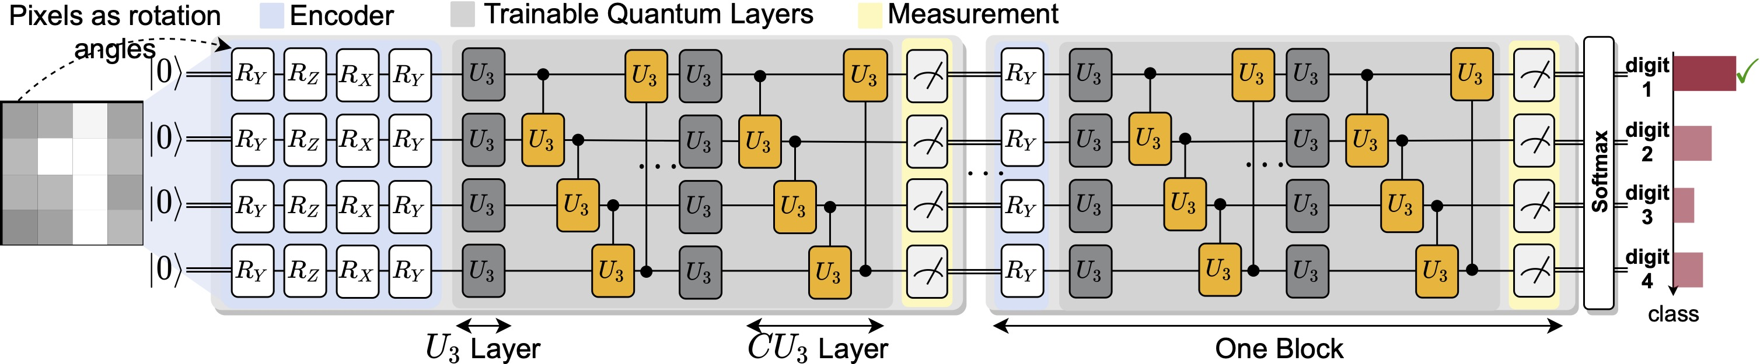
PQC Circuit in QuantumNAT
QNN with multiple nodes
Encoder
Trainable Quantum Layers
Measurements

Slide 97
Three Techniques in QuantumNAT
QuantumNAT:
Normalization: mitigate noise impact
Noise injection: make the parameters aware of noise
Quantization: mitigate noise impact

Slide 98
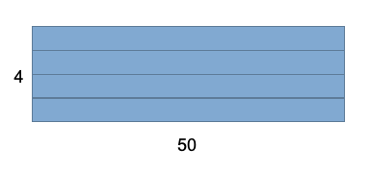
Post-Measurement Normalization
Normalize the measurement outcome
Along the batch dimension
For example, we train the 4-qubit PQC with batch=50 then we have results as 50 * 4 values

Slide 99
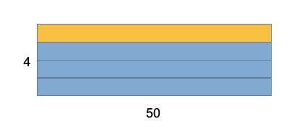
Post-Measurement Normalization
Normalize the measurement outcome
Along the batch dimension
For example, we train the 4-qubit PQC with batch=50 then we have results as 50 * 4 values
Compute the mean and std on of the measurement outcome on each qubit across batch dim

Slide 100
Post-Measurement Normalization
Normalize the measurement outcome
Along the batch dimension
For example, we train the 4-qubit PQC with batch=50 then we have results as 50 * 4 values
Compute the mean and std on of the measurement outcome on each qubit across batch dim
Normalize the measurement outcome with the computed mean and std

Slide 101
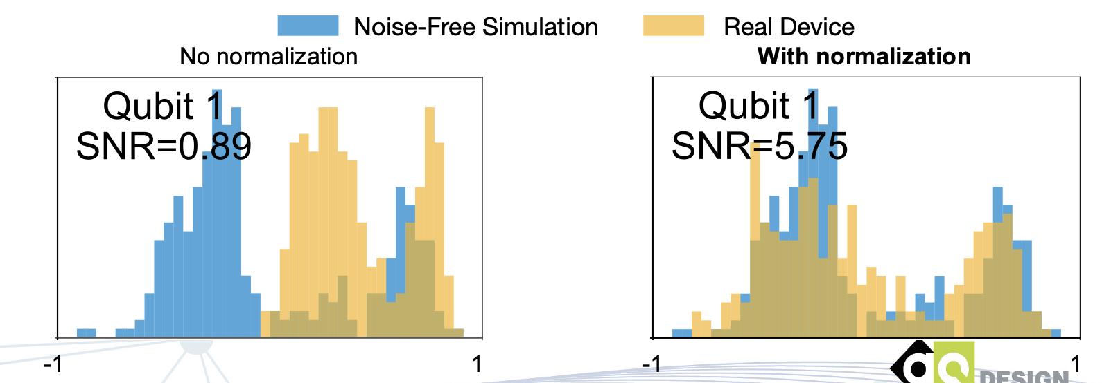
Post-Measurement Normalization
Normalize the measurement outcome
Along the batch dimension
Measurement outcome distribution of 50 quantum circuits:
-1
1
-1
1

Slide 102
Post-Measurement Normalization
Normalize the measurement outcome
Along the batch dimension
Measurement outcome distribution of 50 quantum circuits:
-1
1
-1
1

Slide 103
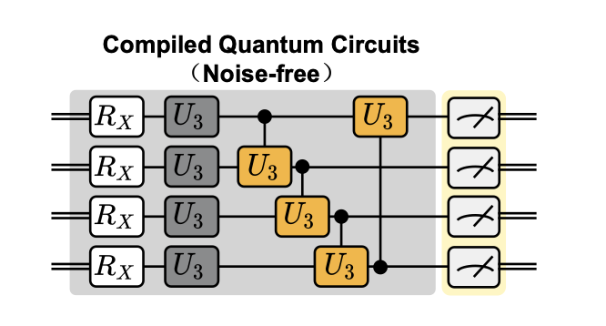
Noise Injection
Inject noise during training on classical simulator
Pauli error
Readout error

Slide 104
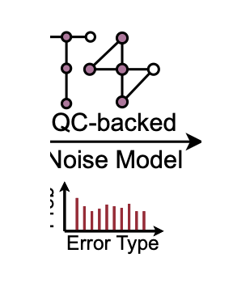
Noise Injection
Inject noise during training on classical simulator
Pauli error
Readout error
Pauli error: SX gate: {X: 0.00096, Y: 0.00096, Z: 0.00096, None: 0.99712}
0.984, 0.016
0.022, 0.978
Readout Error Matrix:

Slide 105
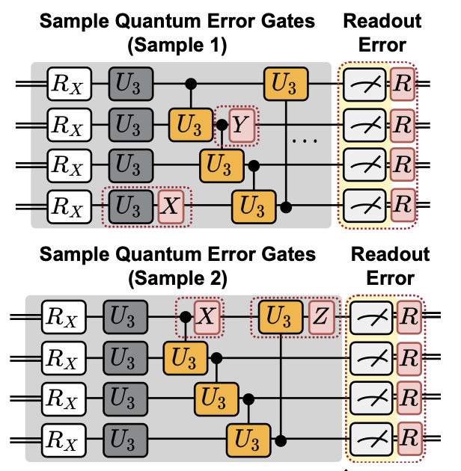
Noise Injection
Inject noise during training on classical simulator
Pauli error
Readout error
Pauli error: SX gate: {X: 0.00096, Y: 0.00096, Z: 0.00096, None: 0.99712}
0.984, 0.016
0.022, 0.978
Readout Error Matrix:

Slide 106
Noise Injection
Inject noise during training on classical simulator
Pauli error
Readout error
Pauli error: SX gate: {X: 0.00096, Y: 0.00096, Z: 0.00096, None: 0.99712}
0.984, 0.016
0.022, 0.978
Readout Error Matrix:

Slide 107
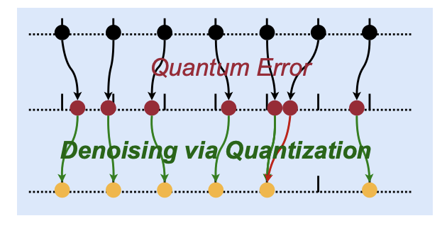
Post-Measurement Quantization
Quantize measurement outcomes
Denoising effect
Small errors will be mitigated

Slide 108
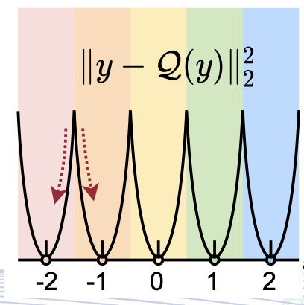
Post-Measurement Quantization
Quantize measurement outcomes
Denoising effect
Small errors will be mitigated
Loss term to encourage measurement outcomes to be close to centroids

Slide 109
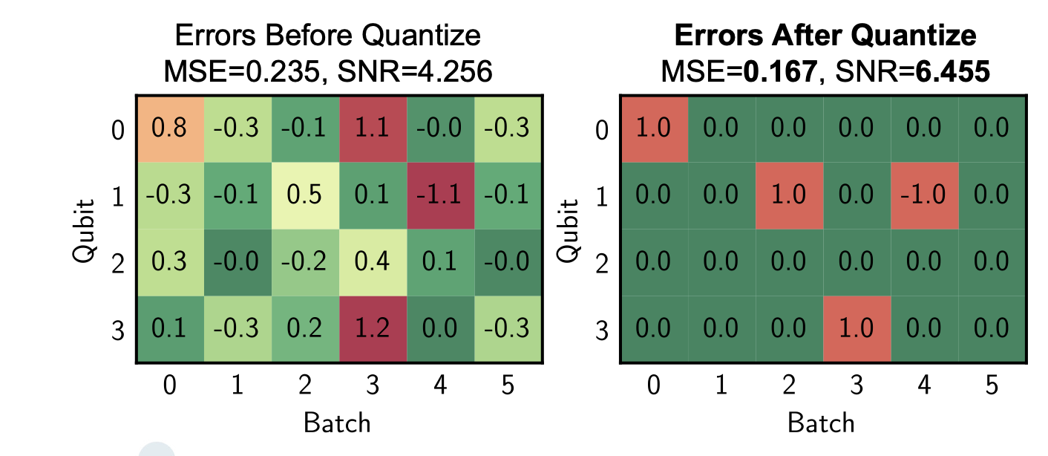
Post-Measurement Quantization
Quantization reduces errors and improves SNR

Slide 110
Evaluation
Benchmarks
Quantum Machine Learning task:
MNIST 10-class, 4-class, 2-class
Fashion MNIST 10-class, 4-class, 2-class
Vowel 4-class
Cifar-2 class
Quantum Devices
IBMQ
#Qubits: 5 to 15
Quantum Volume: 8 to 32

Slide 111
Evaluation
QuantumNAT significantly improves real measurement accuracy

Slide 112
Consistent Improvements on Various Benchmarks
On IBMQ santiago
Method | MNIST-4 | FMNIST-4 | Vowel-4 | MNIST-2 | FMNIST-2 | Cifar-2
Baseline | 0.30 | 0.32 | 0.28 | 0.84 | 0.78 | 0.51
+ Normalization | 0.41 | 0.61 | 0.29 | 0.87 | 0.68 | 0.56
+Noise Injection | 0.61 | 0.70 | 0.44 | 0.93 | 0.86 | 0.57
+ Quantization | 0.68 | 0.75 | 0.48 | 0.94 | 0.88 | 0.59

Slide 113
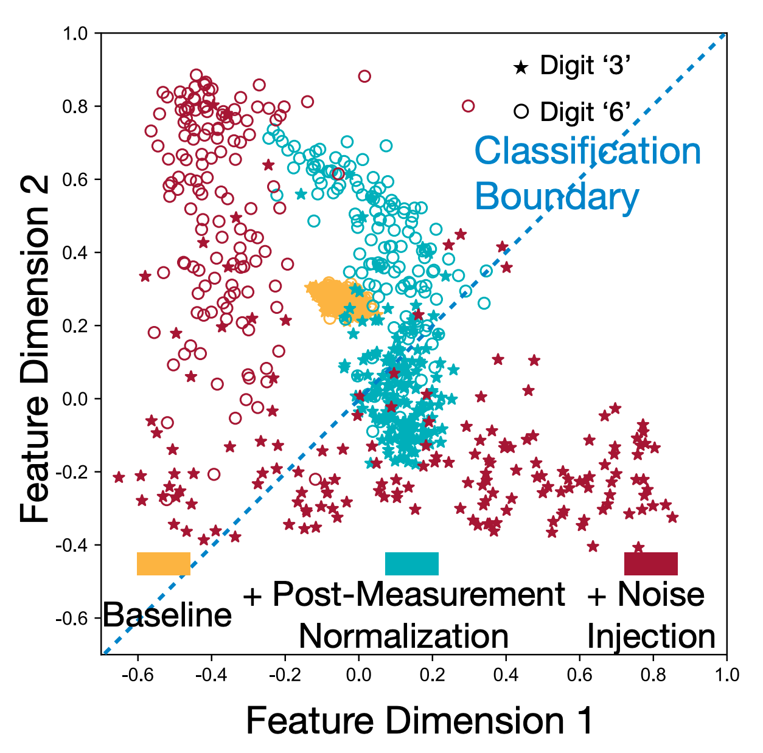
Visualization
QuantumNAT stretches the distribution of features
MNIST-2 classification task

Slide 114
Noise Model in TQ
noise_model_tq = tq.NoiseModelTQ(
noise_model_name='ibmq_quito’,
factor=10,
add_thermal=True
)

Slide 115
Hands-On Section 2.2 QuantumNAT

Slide 116
TorchQuantum Tutorial Outline
Section 1
Section 2
Section 3
TorchQuantum Basic Usage
Use TorchQuantum on Gate level
Use TorchQuantum on Pulse level
1.1 Quantum Basics
2.1 QuantumNAS: Ansatz Search and Gate Pruning
1.2 TQ operations
3.1 Quantum Optimal Control
2.2 QuantumNAT: Noise Injection and Quantization
1.3 TQ for State Prep
2.3 QOC: On-Chip Training
3.2 Variational Pulse Learning
1.4 TQ for VQE
2.4 Transformer for Quantum Circuit Reliability Prediction
1.4 TQ for QNN
2.5 QNN Compression

Slide 117

QOC for High Scalability
How to further improve the scalability of PQC training?
Train the parameters directly on real quantum machine

Slide 118
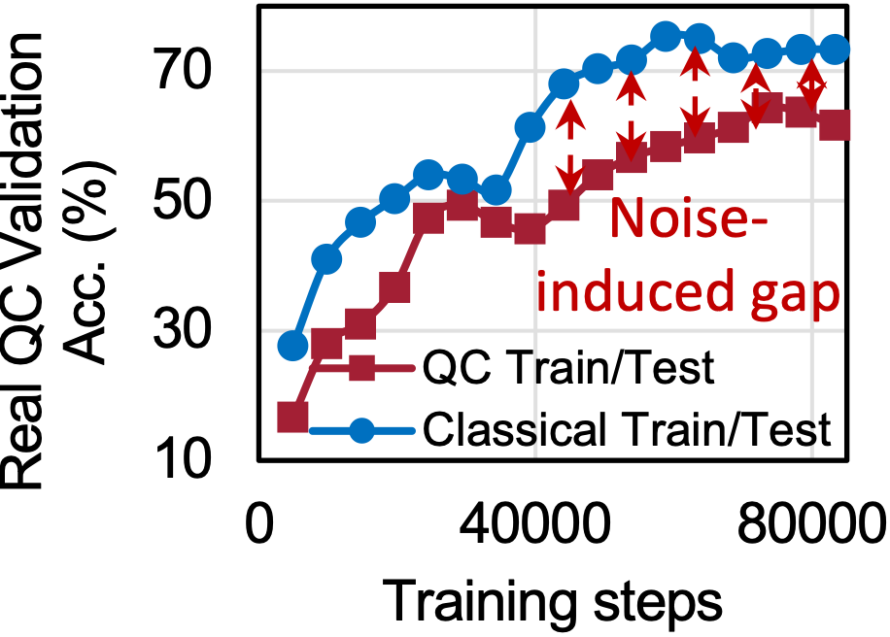
Challenge of On-chip Training: noise
Noise reduces reliability of on-chip computed gradients

Slide 119
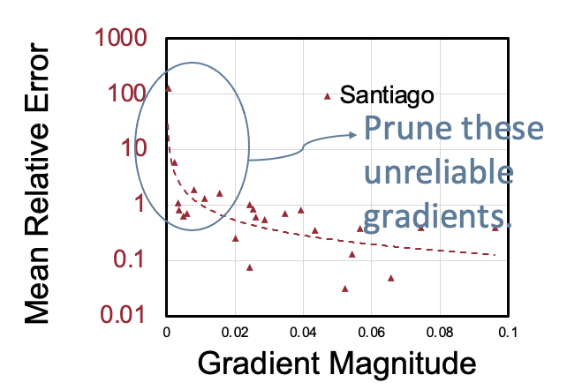
Challenge of On-chip Training: noise
Noise reduces reliability of on-chip computed gradients
Small magnitude gradients have large relative errors

Slide 120


Parameter Shift Rules
Calculate the gradient of $θ$ w.r.t. $f\left(θ\right).$

Slide 121
Parameter Shift Rules
Calculate the gradient of $θ$ w.r.t. $f\left(θ\right).$

Slide 122



Parameter Shift Rules
Shift $θ$ twice
$$\frac{∂}{∂θ}f\left(θ\right)=\frac{1}{2}\left(f\left(θ+\frac{π}{2}\right)−f\left(θ−\frac{π}{2}\right)\right)$$

Slide 123

Parameter Shift Rules
This formula is valid to all rotation gates
RZ, RY, RX, RXX, RZZ
One gradient requires two runs on real quantum machine
$$\frac{∂}{∂θ}f\left(θ\right)=\frac{1}{2}\left(f\left(θ+\frac{π}{2}\right)−f\left(θ−\frac{π}{2}\right)\right)$$

Slide 124


Calculate Gradients of PQC
Step 1: Run on QC without shift to obtain $f$

Slide 125


Calculate Gradients of PQC
Step 2: Further forward to get $Loss$

Slide 126


Calculate Gradients of PQC
Step 3: Backpropagation to calculate $\frac{∂Loss}{∂f\left(θ\right)}$

Slide 127

Calculate Gradients of PQC
Step 4: Shift twice and run on QC to calculate $\frac{∂f(θ)}{∂θ_{i}}$

Slide 128

Calculate Gradients of PQC
Step 5: By Chain Rule: $\frac{∂Loss}{∂f\left(θ\right)}\frac{∂f(θ)}{∂θ_{i}}=\frac{∂Loss}{∂θ_{i}}$, sum over 4 passes (4 qubits)
Only forward on quantum device

Slide 129
Probabilistic Gradient Pruning
Small magnitude gradients have large relative errors

Slide 130

Probabilistic Gradient Pruning

Slide 131

Accumulation Window
Keep a record of accumulated gradient magnitude

Slide 132

Accumulation Window
Normalize the accumulated gradient magnitude to a probability distribution

Slide 133

Accumulation Window
Prune the calculation of some gradients according to the probability distribution

Slide 134
Evaluation
Benchmarks
Quantum Machine Learning task: MNIST 4-class, 2-class, Fashion MNIST 4-class, 2-class, Vowel 4-class
Variational Quantum Eigensolver task: H2 molecule
Quantum Devices
IBMQ
#Qubits: 5 to 7
Quantum Volume: 8 to 32
Circuit architecture
RZZ+RY, RXYZ+CZ, RZX+RXX

Slide 135
Evaluation
Benchmarks
Quantum Machine Learning task: MNIST 4-class, 2-class, Fashion MNIST 4-class, 2-class, Vowel 4-class
Variational Quantum Eigensolver task: H2 molecule
Quantum Devices
IBMQ
#Qubits: 5 to 7
Quantum Volume: 8 to 32
Circuit architecture
RZZ+RY, RXYZ+CZ, RZX+RXX

Slide 136

QNN results
QOC achieved similar results to classical simulation

Slide 137

QNN Training Curves
Classical Train: Train on classical simulator and test on real QC
QC Train: Train and test the model on real QC
QC Train-PGP (QOC): Train and test on real QC with gradient pruning

Slide 138
QNN Training Curves
Gradient pruning can brings 2%~4% accuracy improvements
Pruning accelerates convergence with 2x training time reduction

Slide 139

VQE Training Curves
Gradient pruning can reduce the gap between quantum and classical

Slide 140

Scalability Improvements
On-chip Training is scalable

Slide 141
Hands-On Section 2.3 Quantum On-chip Training

Slide 142
TorchQuantum Tutorial Outline
Section 1
Section 2
Section 3
TorchQuantum Basic Usage
Use TorchQuantum on Gate level
Use TorchQuantum on Pulse level
1.1 Quantum Basics
2.1 QuantumNAS: Ansatz Search and Gate Pruning
1.2 TQ operations
3.1 Quantum Optimal Control
2.2 QuantumNAT: Noise Injection and Quantization
1.3 TQ for State Prep
2.3 QOC: On-Chip Training
3.2 Variational Pulse Learning
1.4 TQ for VQE
2.4 Transformer for Quantum Circuit Reliability Prediction
1.4 TQ for QNN
2.5 QNN Compression

Slide 143

Transformer for Quantum Circuit Reliability Prediction
Use the circuit graph information

Slide 144


Transformer for Quantum Circuit Reliability Prediction
Use PST as the metrics

Slide 145

Dataset collection
Collect dataset on real machine / noisy simulator

Slide 146

Features on each node

Slide 147

Graph Transformer
Graph Transformer

Slide 148

Evaluation
On random generated circuit

Slide 149

Evaluation
Circuits from quantum algorithms

Slide 150
More info
Checkout https://qmlsys.mit.edu/#transformer for paper

Slide 151
TorchQuantum Tutorial Outline
Section 1
Section 2
Section 3
TorchQuantum Basic Usage
Use TorchQuantum on Gate level
Use TorchQuantum on Pulse level
1.1 Quantum Basics
2.1 QuantumNAS: Ansatz Search and Gate Pruning
1.2 TQ operations
3.1 Quantum Optimal Control
2.2 QuantumNAT: Noise Injection and Quantization
1.3 TQ for State Prep
2.3 QOC: On-Chip Training
3.2 Variational Pulse Learning
1.4 TQ for VQE
2.4 Transformer for Quantum Circuit Reliability Prediction
1.4 TQ for QNN
2.5 QNN Compression

Slide 152
Quantum Neural Network Compression
How to Compress a Quantum Neural Network?
https://arxiv.org/pdf/2207.01578.pdf
Accepted by IEEE/ACM International Conference on Computer-Aided Design 2022
Zhepeng Wang (Presenter), Zhirui Hu, Dr. Weiwen Jiang
Department of Electrical and Computer Engineering
Jqub @ George Mason University
Notes:
Hello, everyone, I am Zhepeng Wang from GMU.
Today I would like to introduce our work on the compression of quantum neural networks, which has been accepted and will be published by this year’s ICCAD.
And the implementation of this work is mainly based on Torch Quantum.

Slide 153


Motivation and Background
Pruning and Quantization in Classical ML
Pruning and Quantization in Quantum ML
Pruning: Not only 0 can be pruned, but also 2π, 4π, etc.
Quantization: Different quantization level may have different cost
Notes:
Firstly, let us briefly review the concept of compression, which includes pruning and quantization, in classical ML.
(figure1)
Arbitrary real valued weights. Prune the value close to zero. …
Quantized to some fixed value level. … For the these quantized value, we can simply their representation on the hardware,
Through compression we can the space for the ml model and also accelerate their computation.
(figure2)
So what does pruning and quantization look like in quantum machine learning?
Figure (e) shows an qml model implemented as a vqc in quantum devices., where the quantum gates have trainable parameters, ……
So why do we want apply p and q on qml model? It is because we can reduce the circuit depth of the physical quantum circuits. and a shorter circuit has benefits like mitigating noise effect and speeding up the execution.
(two key points)
By comparing the p and q in classical and ml, we can find two major differences…
(two figures)
This two points can be illustrates with this two figures.
FPGA

Slide 154



Motivation and Background
Quantum Neural Network Compression Should be Compilation Aware
Compilation
Notes:
In this slides, we show an example of qc before and after compilation
As you can see, the three logical gates are decomposed to the basis gates and each one have different length after the compilation
(table)
This table is a example summarizing the depth of different gates through the qiskit compiler.
As you can see, when type of gates/ the value of the rotation is different -> …
And it is expected that when we compile the circuit with different settings, such as different basis gates. The table should be different.
Therefore, we claim that ….

Slide 155

CompVQC
General Overview
Three stages: 1. Preparation; 2. Compression; 3. Deployment
Notes:
Based on the observations we mentioned before, we propose compvqc, a framework to compress qnn implemented as vqc.
And there are three steps to go through to run qnn model on quantum computers with compvqc

Slide 156
CompVQC
LUT Construction and Training a Quantum Model
Reconstruct LUT for ADMM
Compression based on ADMM
Deployment
Notes:
Now lets go the details of each stages. Firstly, we take a look at the stage 1: preparation

Slide 157
CompVQC
LUT Construction and Training a Quantum Model
Notes:
In stage 1. we need to prepare the required input to the stage 2, the compression.
More specifically, we first need to build a compression level lut. The input to build it includes ….
Besides, we need to pretrain a qnn for compression

Slide 158


CompVQC
LUT Construction and Training a Quantum Model
Compression-Level Lookup Table (LUT)
A combination of pruning/quantization level called as “compression level”.
VQC Pre-Training
A VQC model is pre-trained for compression and the training process is implemented with Torch Quantum.
Notes:
In this slides, we want to emphasize that compression level is a combination of …, which is clearly show in the figure, where the green part corr..
The blue part corr …
And as we mentioned before,
For Pruning: Not only 0 angle can be pruned, # but also 2π, 4π, etc.
For Quantization: Different quantization level may have different cost
Besides, for the vqc pretraining, we want to highlight that …

Slide 159


Hands-On Tutorial (1) : LUT Construction
Input
Fixing points list
Logical Gates List to be used
Quantum Backend
Do
Get the compiler for the backend
Get the compiled circuit length of each Logical Gate at each special fixing points
Output
Compression-Level Lookup Table (LUT)
Notes:
So now, let us come to the tutorial session for this step.

Slide 160


Hands-On Tutorial (1) LUT Construction
Notes:
Now let’s run the codes on colab.

Slide 161
CompVQC
LUT Construction and Training a Quantum Model
Reconstruct LUT for ADMM
Compression based on ADMM
Deployment
Notes:
So after we finish the step 1, we will come to the second stage: compression. And the first step is to ….
alternating direction method of multipliers (ADMM) (approach)

Slide 162
CompVQC
Problem Definition
Given VQC W(θ), LUT T, quantum compiler C, the problem is to determine trainable parameters θ, such that:
f (W(θ)): training loss on the given dataset
TCD(θ): the circuit depth of VQC
Notes:
Before we do the reconstruction, we want to formally define the compilation-aware qnn compression problem
Each theta should pick one compression level from the lut

Slide 163


CompVQC
Reconstruction LUT for ADMM
Process is conducted by traversing all quantum gates in VQC and select the compression target with highest metric.
A heuristic metric for the choice
acc(W(θ^{i, k})): the accuracy of the VQC under new parameters
TCD(θ): the inverse of the compression ratio by changing parameters from θ to θ^{i, k}
Notes:
In compvqc, we choose ADMM to solve the cqcp problem we formulated,
But before we apply ADMM, we want to reduce the search space for ADMM, which is the motivation for us to reconstruct the lut.
More specifically,
In this reconstructed lut, each row corresponds to each quantum gates in the vqc.
Instead of having multiple choice of compression level, it now only has one target compression level, which will be used for the admm.
Therefore, process is ……

Slide 164


Hands-On Tutorial (2) : Reconstruct LUT for ADMM
Input
A trained model
Original LUT
The metrics function of accuracy and length
For each parameter, Do
Replace it with points at compression level in original LUT while fixing other parameters
Calculate the metrics of each new model
Select the point with the highest metric as the compression level for ADMM
Output
A new LUT for ADMM

Slide 165
Hands-On Tutorial (2) Reconstruct LUT for ADMM

Slide 166
CompVQC
LUT Construction and Training a Quantum Model
Reconstruct LUT for ADMM
Compression based on ADMM
Deployment
Notes:
After we get reconstruct the lut, we can now compress the qnn with admm

Slide 167
CompVQC
Compression based on ADMM
Each parameter can either be compressed to the target value in T^{admm} or not compressed.
Notes:
In this step, we relax the constraint in the original cqcp problem, which means not all will be compressed, in order to maintain the accuracy
More specifically, Each parameters …
(go through figure)
To recover the accuracy, we will retrain the model while fixing parameters in the compressed gates.

Slide 168


CompVQC
Compression based on ADMM
Given reconstructed compression-level LUT T^{admm}, the CQCP is formulated as:
Z: a set of auxiliary variables for subproblem decomposition and z_{i} ∈ Z is corresponding to θ_{i} ∈ θ
f(W(θ)) + TCD(Z) : the objective function in the original CQCP problem(previously seen).
c_{i}(Z_{i}): An indicator function to serve as a penalty term
mask^{r}: variable to indicate whether the parameters will be compressed at iteration r.
Notes:
This slides shows more details about the ADMM for qnn compressions
……
If you are interested in the whole optimization process, you can refer to our paper on arxiv

Slide 169


Hands-On Tutorial (3) : Compression based on ADMM
Input
A trained model
A new LUT for ADMM
Original model:
Do
Compress a model with ADMM
Fine-tune the compressed model
Output
A compressed model
Compressed model:
Pruned
 | Circuit Length | Accuracy
Original model | 51 | 95.6%
Compressed | 21 | 96.60%
Quantized

Slide 170
Hands-On Tutorial (3) Compression based on ADMM

Slide 171
CompVQC
LUT Construction and Training a Quantum Model
Reconstruct LUT for ADMM
Compression based on ADMM
Deployment
Notes:
After the compression, finally, we will deploy the compiled vqc onto the quantum computers for execution

Slide 172
CompVQC
Deployment
Notes:
Due to the time of limit, we do not arrange a hands on session for the deployment.

Slide 173
CompVQC
General Overview
Three stages: 1. Preparation; 2. Compression; 3. Deployment
Notes:
So now we have gone through all of the three stages of compvqc

Slide 174



Experimental Results
Simulation Results on ML Dataset
CompVQC can maintain high accuracy with <1% accuracy loss. And the reduction of circuit length is up to 2.5X.
Notes:
And let‘s take a look at some experimental results.
This slides shows the simulation results on …. We compare the compvqc with four baselines, …
In this table, we can conclude that ….
The figure on the bottom show that comp vqc could Push forward the pareto optimal in terms of circuit depth and accuracy
The right figure shows the experiments on data sets with increasing classes. We can see that under all the settings, compvqc could archieve higher accuracy with shorter circuit than the other compression baseline.

Slide 175


Experimental Results
Results on Multiple IBM Quantum Computers
CompVQC can reduce circuit length by 2x while the accuracy is also higher in a noisy environment
Circuit compression can make the QNN model more robust to the noise
Notes:
We also evaluates the compvqc on multiple … with synthetic datasets. And we can conclude that

Slide 176
TorchQuantum Tutorial Outline
Section 1
Section 2
Section 3
TorchQuantum Basic Usage
Use TorchQuantum on Gate level
Use TorchQuantum on Pulse level
1.1 Quantum Basics
2.1 QuantumNAS: Ansatz Search and Gate Pruning
1.2 TQ operations
3.1 Quantum Optimal Control
2.2 QuantumNAT: Noise Injection and Quantization
1.3 TQ for State Prep
2.3 QOC: On-Chip Training
3.2 Variational Pulse Learning
1.4 TQ for VQE
2.4 Transformer for Quantum Circuit Reliability Prediction
1.4 TQ for QNN
2.5 QNN Compression

Slide 177
TorchQuantum Tutorial Outline
Section 1
Section 2
Section 3
TorchQuantum Basic Usage
Use TorchQuantum on Gate level
Use TorchQuantum on Pulse level
1.1 Quantum Basics
2.1 QuantumNAS: Ansatz Search and Gate Pruning
1.2 TQ operations
3.1 Quantum Optimal Control
2.2 QuantumNAT: Noise Injection and Quantization
1.3 TQ for State Prep
2.3 QOC: On-Chip Training
3.2 Variational Pulse Learning
1.4 TQ for VQE
2.4 Transformer for Quantum Circuit Reliability Prediction
1.4 TQ for QNN
2.5 QNN Compression

Slide 178

Brief Overview of Workflow
When we want to execute a quantum program on a quantum computer, we need to compile it first:
Notes:
The program is first compiled into .qasm files.
Since the qubits in current quantum hardware is not fully-connected. Some gates in .qasm files could not be performed on quantum computer. The conflicts need to be solved through qubit mapping.
The mapped .qasm files are then translated into control-pulses and executed on quantum computer.
Currently control pulses are generated through gate-based compilation.
We manage to mitigate cross-talk effects with our mapping algorithm.
We divide programs into groups of gates. Instead of generating pulses for gates, we generate pulses for groups.

Slide 179



Pulse-Based and Gate-Based
Gate- and Pulse-level are two different abstraction layers.

Slide 180

Pulse-Based and Gate-Based
The microwave is used to control the quantum bits.
Krantz, Philip, et al. "A quantum engineer's guide to superconducting qubits." Applied Physics Reviews 6.2 (2019): 021318.

Slide 181

Gate-based Compilation
Each gate corresponds to a pulse. One-by-one concatenation of all pulses realize the function of many gates.
Notes:
Each gate corresponds to a pulse. One-by-one concatenation of all pulses realize the function of many gates.
The gate-based compilation requires little computing resource.
The outcome pulse latency is high.

Slide 182

Quantum Optimal Control(QOC)
QOC is commonly used to generate pulses (from target unitary matrices to pulses)
QOC is computationally expensive
Notes:
Gradient methods are resource consuming
The latency of pulse is reduced compared to gate-based method.
Takes hours/days to generate pulses for large quantum programs
Compilation times exponential to the number of Qubits

Slide 183

Quantum Optimal Control (QOC)
As shown in the figure, the control pulse is divided into multiple time slots. The amplitude of each time slot will be adjusted through optimization.
Shi, Yunong, et al. "Optimized compilation of aggregated instructions for realistic quantum computers." 2019.
Notes:
QOC is basically an optimization problem. By updating control pulses, the final unitary matrix of these control pulses will approximate the target unitary matrix.
As shown in the figure, the control pulse is divided into multiple time slices. The amplitude of each slice will be adjusted through optimization.
Therefore, the initialization of control pulses will effect the #iterations. If the initial pulse and the final pulse is similar. We expect to see faster convergence.

Slide 184


Accqoc: Group-based Pre-compilation
Instead of dealing with single gate, we generate pulses from groups of gates.
Notes:
We adopt the greedy strategy to partition the quantum programs by bit dividing and layer dividing.
In this way, we could generate groups of desired size.

Slide 185

Accqoc: Group-based Pre-compilation
We limit the size of the groups that QOC takes. (Key Insight)
Notes:
We limit the size of the groups that QOC takes. In this way:
The QOC is relatively fast and it still reduces the overall latency.
Similarity between these groups could be utilized to accelerate QOC
When the group size is small. We could build a library for group-pulse relationship.
It’s similar with the idea of pre-compilation in classical computing.

Slide 186

Build the Library
Pulses of these groups will be generated through QOC. And we get a library that stores group-pulse pairs.
Notes:
This part is static pre-compilation.
We take various quantum programs as profiling programs:
These programs are divided into groups of proper size.
Pulses of these groups will be generated through QOC.
Finally we get a library that stores group-pulse relationship.
QOC needs a target latency to start. The target latency is determined through binary search:
If the latency is too long, the constraint is loose, the target latency will be decreased.
If the latency is too short, the constraint is tight, the QOC does not converge in certain iterations, the target latency will be increased.

Slide 187

Utilize the Library
For groups that are covered by library, the pulse could be directly looked up.
For uncovered groups, we could generate the pulses using pulses of very similar groups

Slide 188







Use MST to Accelerate QOC
We need to define similarity and find the corresponding Minimum spanning tree.
Notes:
We find that similar groups could accelerate the QOC.
Similarity is properly defined for groups of gates.
To make sure that groups are generated from the most similar group, we construct a similarity graph.
To obtain the MST of this graph, we can find a sequence to generate pulses.
First, we need to define similarity. This figure shows that similar groups could help reduce the #iterations of QOC. And unsimilar groups will increase the #iterations of QOC

Slide 189

Latency Reduction over Gate-based
This figure shows the latency reduction compared with gate-based compilation. We show that the latency is reduced for various grouping strategy.
Notes:
This figure shows the latency reduction compared with gate-based compilation. We show that the latency is reduced for various grouping strategy.(how programs are divided into groups)
The red bar shows extra latency reduction, when we spend more time on QOC of the most frequent group.(More time budget for that group to reach tighter target latency)
Average latency reduction is 2.43x

Slide 190

Latency Reduction V.S. Brute-force
This figure shows the latency reduction compared with brute-force compilation. Brute-force QOC means that we give QOC a very large group of gates to reach maximum latency reduction.
Notes:
This figure shows the latency reduction compared with brute-force compilation. Brute-force QOC means that we give QOC a very large group of gates to reach maximum latency reduction.
We can see that smaller groups can reach similar latency reduction with much less computation resource.(2.43x V.S. 3.01x)
Compilation time reduction compared with brute-force QOC is 9.88x

Slide 191

Reduction of Training Iteration
We see reduction of training iteration when we adopt the idea of similarity.
Notes:
We see reduction of training iteration when we adopt the idea of similarity.
The reduction ratio is low due to the limited size of benchmarks.
We expect to see higher ratio with larger programs.(more groups and more similar)
The bars of different colors corresponds with different definition of ‘similarity’.

Slide 192
Hands-On Section 3.1 Quantum Optimal Control

Slide 193
TorchQuantum Tutorial Outline
Section 1
Section 2
Section 3
TorchQuantum Basic Usage
Use TorchQuantum on Gate level
Use TorchQuantum on Pulse level
1.1 Quantum Basics
2.1 QuantumNAS: Ansatz Search and Gate Pruning
1.2 TQ operations
3.1 Quantum Optimal Control
2.2 QuantumNAT: Noise Injection and Quantization
1.3 TQ for State Prep
2.3 QOC: On-Chip Training
3.2 Variational Pulse Learning
1.4 TQ for VQE
2.4 Transformer for Quantum Circuit Reliability Prediction
1.4 TQ for QNN
2.5 QNN Compression

Slide 194


Variational Quantum Pulse Learning (VQP)
Coherence time is limited in NISQ machines, which means we cannot perform a huge quantum circuit with enough depth and width in NISQ machines.
Noise and compilation overhead seriously affect the performance of a quantum program.
Error rate on a bit in CMOS Device error rate is about 10⁻¹⁵
But error rate on a quantum bit reaches 10⁻⁴ to 10⁻²

Slide 195

Motivation and Challenges
QOC is limited to few qubits since it is computationally expensive.
Most works demonstrate QOC on quantum simulators, however, it is hard to be evaluated on NISQ machines.
Notes:
Quantum Optimal Control (QOC):
Finding an optimal control scheme from a class of allowed control schemes that moves the system from some initial state to a specified target state whose performance is optimal.
Given a unitary matrix, we can use optimal control to find a theoretically best control pulse achieving reduction of pulse latency and increase quantum volumes.

Slide 196




Attempt on Quantum Neural Network
Can we find an intermediate-level approach between the gate level operations and quantum optimal control?
Can we achieve benefits by doing so?

Slide 197




Why Variational Quantum Pulse Learning？
VQC with more gates has similar performance in terms of accuracy

Slide 198


Optimization Framework

Slide 199

Experiment Result
Achieves higher accuracy under same condition
VQC with more gates has similar performance in terms of accuracy

Slide 200


Benefits Observed from VQP
Advantage in specific gate
Advantage in general circuit

Slide 201


Challenge for Pulse Learning
Non-gradient-based optimizer has randomness when parameter in high dimensional space.
Qiskit pulse simulator is not efficient, e.g., need around 3 mins to finish a 9-gate circuit.
Notes:
This table shows the VQC with gradient-based algorithm and VQP with Bayesian optimization framework, both for same machine learning task.
Gradient based algorithm shows advantages than BO based.
Solution and future task:
Improvement on optimization process.
Developing an efficient and differentiable pulse simulator.

Slide 202

Pulse Ansatz on VQAs
Can we find a hardware efficient ansatz at the pulse level?
What is a good pulse ansatz?

Slide 203



Benefits of Pulse Ansatz
Source of Advantages:
Enable flexible and efficient compilation workflow on pulse-level.

Slide 204




Benefits of Pulse Ansatz
Source of Advantages:
Two-qubit pulse is tunable, whereas two-qubit gates have few flexibility.
❌Nothing can do with two qubits gate
✔ Parameters are tunable on control channel.

Slide 205

Benefits of Pulse Ansatz
Source of Advantages:
Capability to tune frequency on pulse-level
Notes:
The circuit is realized through frequency-tuned pulse sequences.
The probability of getting |00> state for the zero detuning indicates that parametric pulse operations are physically feasible and can be implemented with high fidelity.
The change of final state under different detuning indicates that the variation of pulse parameter indeed physically changes the corresponding quantum operations.
we apply the measurement error mitigation technique which reduces the impact of readout errors.

Slide 206


Framework and Evaluation
Progressive learning fix the problem that non gradient optimizer cannot hold high dimensional parameters, and progressive approaching to target point is also fit the quantum speed limit (QSL) theory.

Slide 207



Framework and Evaluation
97.3% reduction in ansatz duration compared to QuantumNAS.
Reduce duration by 73.6% compared to RealAmplitude Ansatz while maintaining ansatz performance.

Slide 208


Framework and Evaluation
HeH+: average accuracy 99.336%, with 99.895% being the highest achievable accuracy. The absolute difference in energy is 0.003H, close to the requirement of computational chemistry error (0.0016H) with only a toy model.

Slide 209


Framework and Evaluation
Verify the effectiveness of progressive learning scheme.
Notes:
Verify the effectiveness of progressive learning scheme.
The inaccuracy to full configuration interaction (FCI) data continue reducing step by step.
Energy trends shows a better energy be found in step II over step I.

Slide 210
Hands-On Section 3.2 Quantum Pulse Learning

Slide 211
Summary
Section 1
Section 2
Section 3
TorchQuantum Basic Usage
Use TorchQuantum on Gate level
Use TorchQuantum on Pulse level
1.1 Quantum Basics
2.1 QuantumNAS: Ansatz Search and Gate Pruning
1.2 TQ operations
3.1 Quantum Optimal Control
2.2 QuantumNAT: Noise Injection and Quantization
1.3 TQ for State Prep
2.3 QOC: On-Chip Training
3.2 Variational Pulse Learning
1.4 TQ for VQE
2.4 Transformer for Quantum Circuit Reliability Prediction
1.5 TQ for QNN
2.5 QNN Compression

Slide 212

Thank you for listening!
https://github.com/mit-han-lab/torchquantum
qmlsys.mit.edu

